Slide 1
NESO Registration Surgery – November 2024
Sub Asset Registration and Management
SLIDO: # 3130959​

Slide 2
Contents
SLIDO: # 3130959
Future for Registration Systems and Processes
Primary BMU Registration Summary
Additional/Secondary BMU Registration Summary
Changes within a BMU
Small Aggregated Asset (SAA) BMU Trial
Questions

Slide 3
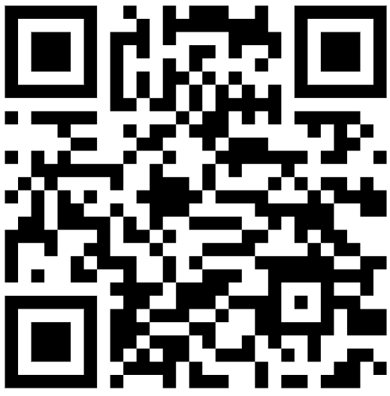
Future of registration
SLIDO: # 3130959
We are changing the way we manage Registrations for the Balancing Mechanism (BM). Early in the new year the process will be moving to the Single Markets Platform (SMP). This will bring BM Registration in line with Balancing Services and enable customers to input and update their unit data directly.
To register for updates on progress and/or the Webinar 23 January please follow the link below or scan the QR Code:
Register

Slide 4
Primary Balancing Mechanism Units
SLIDO: # 3130959
Primary BMUs are can be aggregated or single site.
We don't hold any sub-asset data for Primary Units.
Primary units are CVA registered. The lead party will have a connection agreement, this process is managed by the Connections Team – the connection agreement details requirements in the Appendix F5.
The NESO BMU Registration Team will provide BMU ID within the registration form.
Primary units submit dynamic data via EDL/EDT.
Any Primary Units that uses EDL (Control Point) will need to be uploaded as part of our bi-monthly SORT Static Upload. The units will need to be uploaded so the Control Room can instruct them.
The ENCC dispatches at a BMU level.
SVA – Supplier Volume Allocation | CVA – Central Volume Allocation
NESO – National Energy System Operator | BMU – Balancing Mechanism Unit
EDT – Electronic Data Transfer | EDL – Electronic Data Log
ENCC – Electricity National Control Centre

Slide 5
Additional Balancing Mechanism Units
SLIDO: # 3130959
Customers who hold a supplier license, can access the BM by registering an ABMU.
Additional BMUs can be single site or aggregated (multiple sub assets within GSP group).
The 14 Supplier Base BMUs need to be registered before an additional can be registered.
Additional BMUs are SVA registered and have a Supplier Agreement. These registrations are managed via the BMU Registration Team (and Balancing Services Contract Manager) – the supplier agreement details requirements in the Appendix F5.
The NESO BMU Registration Team will provide BMU ID within the registration form.
Additional units submit dynamic data via EDL/EDT.
Additional units use a Control Point and will need to be uploaded as part of the SORT Static process.
The ENCC dispatches at a BMU level.

Slide 6
Secondary Balancing Mechanism Units
SLIDO: # 3130959
Secondary BMUs are registered by Virtual Lead Parties (VLP) and can either be aggregated or non-aggregated. Aggregation is permitted within GSP Group.
Pre-qualification and onboarding is completed by the market participant via the online Salesforce portal. All BMU and sub asset data that make up the BMU is required.
NESO review the application and once the application is approved, the SBMU ID is autogenerated by Salesforce.
For large volumes of sub-assets, NESO have a pre-qualification offline template for market participants to use – NESO will support creating your online application via salesforce and upload your sub assets for your application.
Secondary units are SVA registered and have a VLP Agreement. These registrations are managed by both the Wider Access Team in Balancing Services and the BMU Registration Team – the VLP agreement details requirements in the Appendix F5.
Secondary units submit dynamic data via EDL/EDT.
Secondary units use a Control Point and will need to be uploaded as part of the SORT Static process.
The ENCC dispatches at a BMU level.

Slide 7
Changes within a BMU
SLIDO: # 3130959
There are several changes market participants may need to make with regards to their NESO BMU. The most common changes are:
Change in MW (change of capacity)
Change in fuel type
Change of location – within GSP group
All changes are processed by the BMU Registration Team, please reach out to the team to discuss in more detail and you will be advised of the next steps and appropriate documentation required.
Please be aware any BMU changes need to be communicated to Elexon before NESO approve for BM systems.
Certain changes may be subject to be included in a SORT Static.
The BMU Registration Team can be contacted at bmu.registration@nationalenergyso.com

Slide 8
SLIDO: # 3130959
 | Primary | Additional | Secondary
Sub Assets |  | Y | Y
Aggregated | Y | Y | Y
Single Site | Y | Y | Y
SVA Registered |  | Y | Y
CVA Registered | Y
Registered by Suppliers |  | Y
Registered by VLP |  |  | Y
EDT/EDL | Y | Y | Y

Slide 9
SLIDO: # 3130959
BM Operational Metering Derogation Update
- Relaxed Metering Requirements for up to 300MW SAA BMUs
SAA BMUs comprise aggregated sub-assets, each below 1MW, into a unit of deliverable capacity of at least 1MW.
Trial of relaxed operational metering standards for SAA BMUs Sep’23-Jan’24 - completed
Positive feedback and NESO decision to allow relaxed metering capacity for up to 300MW SAA BMUs to operate in the BM. Updated Agreements and Appendix F5.
Additional project to review operational metering requirements
Through the trial we also identified further work to support SAA units in the BM

Slide 10
SLIDO: # 3130959
Relaxed Metering Capacity SAA BMUs in the BM (300MW)
- challenges
Registration processes and systems and processing MPAN /AMSID data – consistency across provider and contract types and aligning with Elexon
Managing large volumes of sub-asset data and assigning the sub-assets to the relevant BMU. New pre-qualification template to allow for bulk upload.
Updating BMU asset (MPAN / AMSID) & ownership registration – frequency and processes – consistency with Elexon
Identifying best practice for operational processes and parameters, e.g. operational metering, operational data accuracy, aggregator impact matrix

Slide 11
SLIDO: # 3130959
Relaxed Metering Capacity – SAA BMU Future
Changes to use SMP to support registration processes and updates for all unit types.
Increasing flexibility.
Operational Metering Standards review – DNV
Review of accuracy of operational data

Slide 12
SLIDO: # 3130959
Questions

