Slide 1
Frequency Risk and Control Report (FRCR) 2025 Webinar – 2: Model and Data
Slido code #FRCR
11 December 2024

Slide 2
Agenda
Slido code #FRCR
Open & Housekeeping
Survey Open
Introduction & Recap
Model in Details
Data Source and Assumptions
Previously Asked Questions
Q&A
Further Information and Close

Slide 3
Housekeeping
Slido code #FRCR
This is FRCR 2025 Webinar-2: Model and Data. FRCR 2025 Webinar-1: Framework and Methodology material can be found from here.
You have been joined in listen only mode with your camera turned off.
To ask your questions live please go to Sli.do event code #FRCR. Ask your questions as early as possible. Slido page remains open until this webinar closes and will re-open when consultation webinar starts.
Please provide your full name and organisation. Questions from unidentified parties will not be answered.
Questions will be answered in the upvoted order whenever possible. We endeavour to answer as many as possible during the session. We may need to take some questions away.
Out of scope questions will not be managed in FRCR webinars and will be forwarded to the appropriate NESO team for response.
Webinar-2 slides are available on NESO website. Recording will be published after the webinar. A full Q&A document will be published by Friday 20 December that includes all Q&As from FRCR Webinar-1 and 2.
Please contact box.sqss@nationalenergyso.com for feedbacks and other comments.

Slide 4
Survey
1. Do you feel more confident in your understanding of FRCR after these webinars?
2. Were there any parts of the content that you feel needed further information or clarity on the topic?
3. What else would you like NESO to do to help you understand this topic?
ⓘ Start presenting to display the poll results on this slide.

Slide 5
Introduction & Recap
Slido code #FRCR
FRCR 2025 Policy will:
Explore system risks and cost benefits from reducing minimum inertia from 120 GVA.s to 102 GVA.s.
Benefits of securing the additional BMU+VS and simultaneous events.
Continue covering timeline of 2025 – 2026 and 2026 – 2027 as requested by Ofgem in 2023.
Timeline:
FRCR 2025 Engagement Plan
Content | Date | Way of Comms
OTF Presentation: FRCR 2025 Scope and Engagement Plan | 20 - Nov | OTF
FRCR 2025 Webinar – 1: Framework and Methodology | 27 - Nov | Webinar (record is available)
FRCR 2025 Webinar – 2: Model and Data | 11 – Dec | Webinar
Methodology and Guidance Document Publication | End of January | OTF Signpost & Publication
FRCR 2025 Consultation | February | OTF Signpost
FRCR 2025 Webinar – 3: Results and Recommendation | Mid of February (TBD) | Webinar (TBD)
Post Consultation Engagement | March | Individual Meetings
Engaging with SQSS Panel & Sign off | March | SQSS Panel Meeting
Submission to Ofgem | 31 – March | Email
We are here

Slide 6
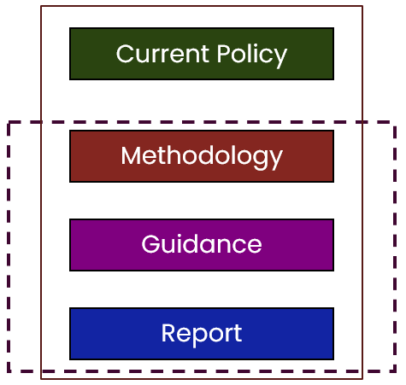
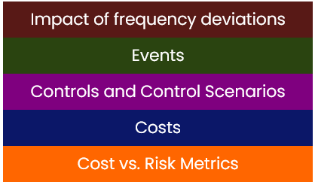
Introduction & Recap
Slido code #FRCR
FRCR 2025 Webinar-1: Framework and Methodology (Link to webinar sides and recording)
Document Structure | Key Definitions

Slide 7
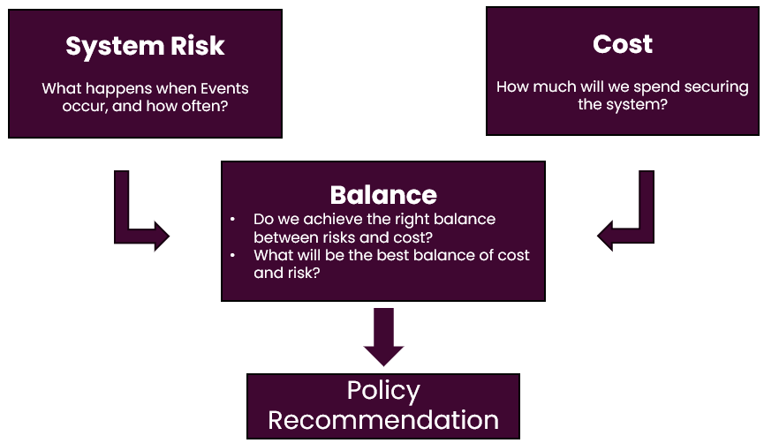
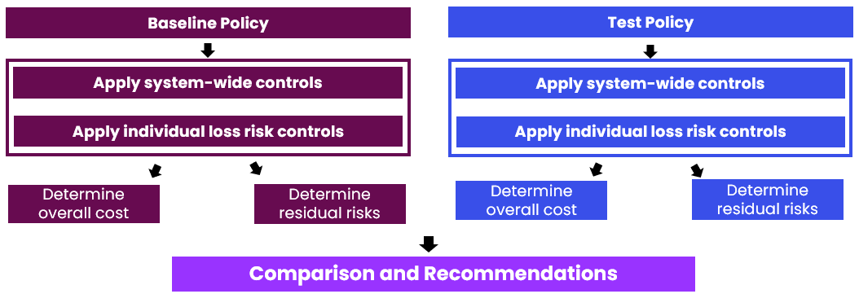
Introduction & Recap
Slido code #FRCR
FRCR 2025 Webinar-1: Framework and Methodology (Link to webinar sides and recording)
What is FRCR? | How do We Model?

Slide 8
Model in Details
Slido code #FRCR
Input Data
Process / Module
Interim Output
Output
BMU Profile
Meeting mini
Inertia Requirement
Inertia MW + £
BMU + VS Profile
Event List
Simul-
taneous profile
Calculate
DC Requirement
DC
MW + £
Overall
Cost
System Inertia
Typical Inertia Price
Calculate Largest Securable Loss for 48.8, 49.2, 49.5 and 50.5Hz events
Pre-fault response + sFFR £
System
Condition
Pre-fault
Response, sFFR, LFSM-O
Typical
Response Price
Demand
Typical BOA price
Apply BOA control
BOA MW + £
Overall
Risk
Historical
Probability
Event Probability
Percentage of time at risk

Slide 9
Model in Details
Slido code #FRCR
Baseline Policy – Calculate Overall Cost
Input Data
Process / Module
Interim Output
Output
Event List
BMU Profile
Meeting mini
Inertia Requirement
Inertia MW + £
BMU + VS Profile
Simul-
taneous profile
Calculate
DC Requirement
DC
MW + £
Overall
Cost
System Inertia
Typical Inertia Price
Calculate Largest Securable Loss for 48.8, 49.2, 49.5 and 50.5Hz events
Pre-fault response + sFFR £
System
Condition
Pre-fault
Response, sFFR, LFSM-O
Typical
Response Price
Demand
Typical BOA price
Apply BOA control
BOA MW + £
Historical
Probability
Overall
Risk
Event Probability
Percentage of time at risk

Slide 10
Model in Details
Slido code #FRCR
Baseline Policy – Calculate Overall system residual risk
Input Data
Process / Module
Interim Output
Output
Event List
BMU Profile
Meeting mini
Inertia Requirement
Inertia MW + £
BMU + VS Profile
Simul-
taneous profile
Calculate
DC Requirement
DC
MW + £
Overall
Cost
System Inertia
Typical Inertia Price
Calculate Largest Securable Loss for 48.8, 49.2, 49.5 and 50.5Hz events
Pre-fault response + sFFR £
System
Condition
Pre-fault
Response, sFFR, LFSM-O
Typical
Response Price
Demand
Typical BOA price
Apply BOA control
BOA MW + £
Historical
Probability
Percentage of time at risk
Overall
Risk
Event Probability

Slide 11
Model in Details
Slido code #FRCR
Apply More DC to Secure BMU+VS Events
Input Data
Process / Module
Interim Output
Output
BMU Profile
Meeting mini
Inertia Requirement
Inertia MW + £
Event List
BMU + VS Profile
Simul-
taneous profile
Calculate
Add. DC
Add. DC
MW + £
Overall
Cost
System
Inertia
Typical Inertia Price
Calculate Largest Securable Loss for 48.8, 49.2, 49.5 and 50.5Hz events
Pre-fault response + sFFR £
System
Condition
Pre-fault
Response, sFFR, LFSM-O
Typical
Response Price
Demand
Typical BOA price
Apply BOA control
BOA MW + £
Historical
Probability
Overall
Risk
Event Probability
Percentage of time at risk

Slide 12
Model in Details
Slido code #FRCR
Apply More DC to Secure BMU+VS Events
Input Data
Process / Module
Interim Output
Output
BMU Profile
Meeting mini
Inertia Requirement
Inertia MW + £
BMU + VS Profile
Event List
Simul-
taneous profile
Calculate
Add. DC
Add. DC
MW + £
Overall
Cost
System
Inertia
Typical Inertia Price
Calculate Largest Securable Loss for 48.8, 49.2, 49.5 and 50.5Hz events
Pre-fault response + sFFR £
System
Condition
Pre-fault
Response, sFFR, LFSM-O
Typical
Response Price
Demand
Typical BOA price
Apply BOA control
BOA MW + £
Historical
Probability
Percentage of time at risk
Overall
Risk
Event Probability

Slide 13
Model in Details
Slido code #FRCR
Apply BOA Control to Secure BMU+VS Events
Input Data
Process / Module
Interim Output
Output
BMU Profile
Meeting mini
Inertia Requirement
Inertia MW + £
Event List
BMU + VS Profile
Simul-
taneous profile
Calculate
DC Requirements
DC
MW + £
System
Inertia
Typical Inertia Price
Overall
Cost
Calculate Largest Securable Loss for 48.8, 49.2, 49.5 and 50.5Hz events
Pre-fault response + sFFR £
System
Condition
Pre-fault
Response, sFFR, LFSM-O
Typical
Response Price
Demand
Typical BOA price
Apply BOA control
BOA MW + £
Historical
Probability
Overall
Risk
Event Probability
Percentage of time at risk

Slide 14
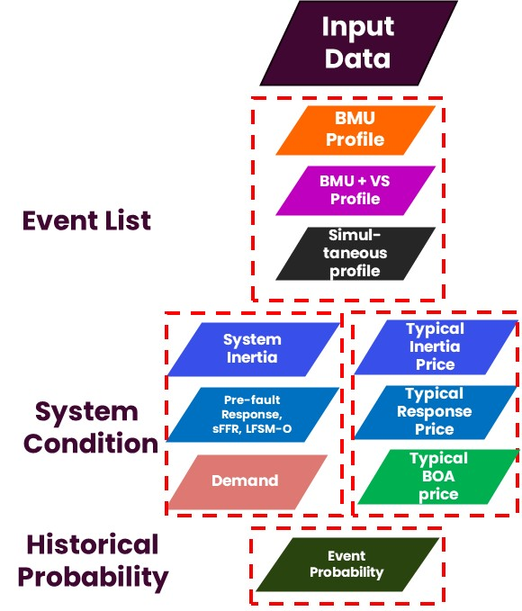
Data Source & Assumptions
Slido code #FRCR
Reminder: General Assumptions
1. Historic vs. Forecast
Analysis uses historical dataset (inertia, demand, generator profile etc.) adjusted for known or expected changes, e.g. new connections, new commissioning / decommissioning NETS in the coming 12-24 months.
2. Granularity and Time Period
Analysis of single snapshot of one point in time, for example winter peak or summer minimum, would not capture the intricacies and interactions or give a true picture of risks exposure. Analysis is performed as a time series (at Settlement Period granularity) for the 2025-26 and 2026-27 periods.
3. Baseline System Conditions
We unwind balancing actions from the historic data sets to get a representation of the “market position” for these baseline system conditions.
4. Cost of Mitigations
Costs are benchmarked against the typical prices for each control.

Slide 15
Data Source & Assumptions
Slido code #FRCR
1. Event List –
BMU Profile
BMU profile details the mean MW output for each generator in each settlement period of the study.
For existing units, the profile is taken from historic data (unwound for any actions taken NESO) from April 2023 to March 2024.
For new connections, where possible we use the output of a similar existing unit (scaled to capacity).
Wind: New wind farms assigned the same load factor profile as the nearest neighbour.
Batteries: Mean profile across several existing batteries.
Interconnectors: Where possible use profile of existing interconnector to the same country
For hybrid units we combine profiles of the two technologies.
PV/Battery: PV profile taken from Sheffield Solar estimate of regional outturn - https://www.solar.sheffield.ac.uk/pvlive/regional/. Combined with mean profile across several existing batteries.
Battery/Gas: Combine mean profile across several existing batteries with historic profile of similar sized gas generator.
In FRCR calculation, consequential Rate of Change of Frequency (RoCoF) volume are considered on top of a BMU profile. Details are in P17.

Slide 16
Data Source & Assumptions
Slido code #FRCR
2. Event List –
BMU + VS Profile
BMU+VS events are defined to represent transmission faults that could lead to loss of BMU(s) and distribution connected generators due to the Vector Shift (VS) relay as one of the Loss of Mains (LoM) protections.
There are 4 types of transmission faults defined in the FRCR model:
Single Circuit,
Double Circuit,
Busbar/Mesh Corner, and
Offshore Transmission Owner (OFTO) network.
Each event has an estimated profile, including the BMU profile and the VS profile.
VS volume is estimated by using weather forecast and the location. FRCR model uses historical profiles for 42 nodes across GB. The nearest / most appropriate node will be assigned to a BMU and the forecasted VS volume will be added on top of the BMU profile. E.g. VS volumes at Lovedean node is assigned to MRWD-1 (Marchwood Unit 1).

Slide 17
Data Source & Assumptions
Slido code #FRCR
BMU + VS Profile
2. Event List – (Continued)
Accelerated Loss of Mains Change Programme (ALoMCP) finished on 31 March 2023, by when, estimated remaining LoM volumes are:
 | 0.125Hz/s | 0.2Hz/s | 0.5Hz/s | Other RoCoF | VS
Estimated total capacity remaining | 54MW | 20MW | 100MW | 4MW | 371MW
Safety margins to cater for uncertainty¹ | 29MW | 31MW | 59MW | 6MW | 1048MW
Further capacity that has undergone enforcement but not formally reported ² | 43MW | 16MW | 31MW | 2MW | 297MW
Total | 126MW | 67MW | 190MW | 12MW | 1717MW
¹ We are working on improving our uncertainty modelling to ensure that margins applied remain economic without accepting undue risks.
² We are working on improving data exchange with DNOs in order to ensure further enforcement of requirements is taken into account.

Slide 18
Data Source & Assumptions
Slido code #FRCR
3. Event List –
Simultaneous
event
Profile
The methodology considers two BMU-only events combining into a simultaneous event due to the computational complexity in investigating higher order events.
Complexity
Simultaneous events (including cascading events), occur less frequently than individual generation failures. Consequently, there are limited instances and data available to develop a comprehensive model for predicting the nature and likelihood of such events.
Causality
Modelling the causality of simultaneous events is challenging due to non-compliance and complex interactions. The analysis focuses on the total cost of securing these events and its residual risk instead of modelling their exact causality.
Probability
Due to the complexity and difficulty in modelling causality, determining the probability of independent events is challenging. The analysis uses historical events (January 2019 – October 2024) where multiple BMUs tripped within a short period of time to calibrate the likelihood of simultaneous events.

Slide 19
Data Source & Assumptions
Slido code #FRCR
Simultaneous
event
Profile
3. Event List – (Continued)
FRCR approach (proposed in FRCR 2022)
How many events should make up a simultaneous event?
The methodology considers two BMU-only events combining into a simultaneous event. We focus on total loss size combined from each pair of BMU losses including any consequential RoCoF losses.
Which pairs of events should make up simultaneous events?
The analysis focuses on a statistical view of the simultaneous event category including the median, 75% quantile (upper quantile) and maximum or peak total loss size per settlement period, due to the large number of possible simultaneous event combinations.
How close in time should events be?
The analysis focuses on a total loss made up of BMU-only events occurring at the same time instant as this represents the most onerous condition.

Slide 20
Data Source & Assumptions
Slido code #FRCR
4. System Condition –
System Inertia
Historic system inertia is estimated for each settlement period from April 2023 to March 2024.
System Inertia is estimated as the sum of the inertia provided by Generators, the contribution from Demand Side and the contribution from Pathfinder Units and Stability Market Y-1 Units.
Inertia provided by each generator is calculated based on its running mode and the inertia factor that is submitted to NESO via its compliance process. This is Market Inertia provided to the system prior to any actions taken by NESO.
Inertia from the demand side is estimated by a demand inertia factor that is derived based on historical frequency events.
Historic values are adjusted to account for additional embedded generation (reducing the National Demand) and increased BMU wind generation.
Units and capacities from Pathfinder Projects and Stability Market (Y-1) are published on NESO website.
Historic estimate of inertia is available from NESO data portal.

Slide 21
Data Source & Assumptions
Slido code #FRCR
5. System Condition –
Typical Inertia Price
The cost to increase inertia is converted from the repositioning cost for a typical inertia unit.
Most of the instructions to procure inertia in the system, If needed, are associated to CCGTs. In this sense, an average CCGTs offer price is calculated using historical data, which is later adjusted by gas and electricity prices.
The reposition price represents a general system price, which takes into consideration all possible technologies that could be used for energy replacement.
Data available from: Elexon – Insights Solution https://bmrs.elexon.co.uk/api-documentation/endpoint/balancing/bid-offer
Inertia Unit | Quantity | Units
MVA.s per additional machine | 3000 | MVA.s
Additional machine SEL (Typical) | 250 | MW
Additional machine MEL (Typical) | 500 | MW
Inertia price data in FRCR 2025
Typical CCGT offer price | £112.50
Typical bid (reposition) price | £42.50
Example
Additional inertia required: 8 GVA.s
Number of typical units required: ceiling (8 GVAs / 3 GVAs) = 3 units
Energy needs to be repositioned: 250 MW * 3 unit = 750 MW
Cost per SP: 750 MW * (112.5 – 42.5)£/MWh * 0.5 h = £26,250

Slide 22
Data Source & Assumptions
Slido code #FRCR
6. System Condition –
Pre-fault
Response, sFFR, LFSM-O
Pre-fault response:
Response services hold to manage frequency within operational range (49.8 Hz – 50.2 Hz)
Dynamic Regulation (DR) and Dynamic Moderation (DM) volumes are considered static for FRCR analysis.
Market supply is approx. 50% over the requirement over the past 12 months with potential growth available from the BESS market.
New Pre-fault modelling is under review. Updated requirement will be communicate to the market
Static Firm Frequency Response (sFFR)
Delivery within 30s after 49.7Hz for a 30 min block.
FRCR2025 therefore the proposal is to use the long run average daily cleared sFFR volumes as in the table below.
EFA1 | EFA2 | EFA3 | EFA4 | EFA5 | EFA6
244 MW | 214 MW | 232 MW | 226 MW | 225 MW | 235 MW
Service | DM | DR
Volume | 170 MW | 330 MW
Limited Frequency Sensitivity Mode – Over frequency (LFSM - O)
The LFSM-O is included in this year’s model as a droop response when frequency is over 50.4 Hz.
The volume of LFSM-O is modelled as 2% of the total generation at each Settlement period, delivered between 50.4 and 50.5 Hz

Slide 23
Data Source & Assumptions
Slido code #FRCR
7. System Condition –
Typical
Response Price
We use historic outturn clearing price to derive a price rather than specific forward forecasts.
Static Firm Frequency Response (sFFR)
Static FRR moved from monthly tenders to a daily day ahead auction from 1st April 2023.
Volume Weighted Average sFFR Price from 1st April 2023 to 24th October 2024.
Dynamic Regulation (DR), Dynamic Moderation (DM) and Dynamic Containment (DC)
Day-ahead auction was moved from EPEX to Enduring Auction Capacity (EAC) platform in November 2023 allowing a more efficient use of market capacity and enabling massive price shift.
Volume Weighted Average Dx Price from 2nd November 2023 to 24th October 2024.
EFA1 | EFA2 | EFA3 | EFA4 | EFA5 | EFA6
1.31 | 2.6 | 4.99 | 3.76 | 5.78 | 4.92
EFA | DCH | DCL | DMH | DML | DRH | DRL
1 | £1.68 | £1.08 | £0.06 | £3.29 | -£4.60 | £7.57
2 | £2.71 | £1.08 | £1.39 | £3.07 | -£2.98 | £7.23
3 | £1.39 | £2.19 | £0.02 | £4.17 | -£5.27 | £8.64
4 | £2.21 | £1.25 | £0.45 | £3.31 | -£4.57 | £7.45
5 | £2.10 | £2.93 | £1.16 | £4.84 | -£4.16 | £9.66
6 | £1.02 | £2.47 | -£0.51 | £4.79 | -£6.20 | £9.48
All historical auction clearing volume and price are accessible from EAC Auction Results.

Slide 24
Data Source & Assumptions
Slido code #FRCR
8. System Condition –
Demand
In FRCR national demand is modelled to provide demand damping effect with an empirical factor of 2.5% per 1 Hz deviation. E.g. with 0.1 Hz deviation, 35 GW demand could change by 87.5 MW which is equivalent to providing response.
Historic half hourly National Demand from April 2023 to March 2024 is used. Data is available from https://www.neso.energy/data-portal/historic-demand-data
Data is adjusted to account for the increase in embedded PV and wind generation.
Determine the historic load factor for PV and wind.
Adjust power output accounting for growth in capacity.
Increase in capacity taken from Future Energy Scenarios (FES) 5-year forecast for FRCR 2025 period of 2025-26, 2026-27:
Assumed additional 200 MW embedded wind and 2500 MW embedded PV.

Slide 25
Data Source & Assumptions
Slido code #FRCR
9. System Condition –
Typical BOA price
Reducing the loss size is one of the controls in the model, and this is achieved by applying Bid and Offers in the Balancing Mechanism (BM).
The prices used in the analysis are derived from 2023/24 Bid and Offer Acceptance (BOA) prices rather than specific forward forecasts. The general assumptions are detailed below
Nuclear is assumed to be inflexible.
BOA prices are benchmarked against different fuel-types.
BOA prices have been determined using the Volume Weighted Average (VWA) of available actions.
Bids are accepted by NESO to reduce generation, offers are accepted to increase generation. Negative bid prices indicate costly actions for those technologies, as NESO must compensate them for reducing their output.
 | Direct action (£/MWh) |  | Replacement (£/MWh)
Fuel type | Bid | Offer | Bid | Offer
Biomass | -292 | n/a | n/a | 121
CCGT | 46 | n/a | n/a | 121
Coal | n/a | n/a | n/a | 121
Hydro | 5 | n/a | n/a | 121
Interconnector | -5 | 117 | 46 | 121
Nuclear | n/a | n/a | n/a | n/a
OCGT | 18 | n/a | n/a | 121
Pumped Storage | -14 | 220 | 46 | 121
Offshore Wind | -165 | n/a | n/a | 121
Taken as inflexible

Slide 26
Data Source & Assumptions
Slido code #FRCR
Event Probability
10. Event Probability – BMU Failure Rate
Determine the historic fault statistics of all Balancing Mechanism Units (BMU) including interconnectors.
Calculate the yearly fault rate per BMU (based on the average for the fuel type).
Go through operational data over past 3 years, half hour by half hour (each settlement period) for each BMU
See when they went from an MEL above zero, to zero, from one half hour to the next and where the 4 hr ahead planned MEL was greater than zero consider this as a breakdown.
Remove any that had multiple breakdowns within 24hrs so just counts as one as they may have struggled returning.
This gives the number of unplanned outages. The number of unplanned outages on a unit type vs the number of units of that type is then used.
For Interconnectors outage messages on REMIT are used from the Elexon Portal (REMIT | Insights Solution)and ENTSOE (Data view).
Data for the BMU outages are from an internal database and is not publicly accessible or shareable.

Slide 27
Data Source & Assumptions
Slido code #FRCR
Event Probability
10. Event Probability – Transmission Fault Rate
We define the events for both the intact network and for an estimate of planned transmission outage. This profile for transmission outage is estimated by a reviewing the previous 3 years of outages.
In FRCR the Transmission Failure events are categorised into: Single Circuit (SC) trip, Double Circuit (DC) trip, busbar/mesh corner risk, and OFTO network risk.
For different type of risks, the fault rates per year are derived as
Circuit_fault_rate = Number_of_circuit_faults / Total_length_of_circuits / Number_of_years
Bar_fault_rate = Number_of_bar_faults / Total_number_of_bars / Number_of_years
We review the fault events from April 2021 to the end of August 2024 that we have recorded. As they are 3rd party data, e.g. from TOs and OFTOs, NESO is unable to publish the raw data. Transmission circuit information can be found from ETYS 2023.
 | Number/Length | Failure Rate | Unit
No. of Busbar/mesh corner (132 kV, 275 kV, 400 kV) | 1838 | 0.29% | fault rate per bar/corner per year
Total circuit length (132/275/400 kV, OFTO excluded) | 24485 | 0.43% | fault rate per km per year
Double circuit length (assumed half of single circuit length) | 12242.5 | 0.06% | fault rate per km per year
OFTO | 2724 | 0.07% | fault rate per km per year

Slide 28
Data Source & Assumptions
Slido code #FRCR
Event Probability
10. Event Probability – Simultaneous Event Probability
Since FRCR 2022, the likelihood of simultaneous events are
1-in-10 years for median simultaneous events
1-in-20 years for upper quantile simultaneous events
1-in-30 years for peak simultaneous events
From FRCR 2025, we use historical cascading events, e.g. events with multiple BMUs tripped within a 2-mins window, from January 2019 to October 2024, to calibrate the likelihood of median, upper quantile, and peak simultaneous events to better reflect the current risks.
In FRCR analysis, we assume cascading events occur simultaneously in the worst-case scenario.
These historical events are benchmarked against the distribution profiles of median, upper quantile, and peak simultaneous events.
The likelihood of simultaneous events is determined by the summation of all Empirical Cumulative Distribution Functions (ECDFs) of those historical events.

Slide 29
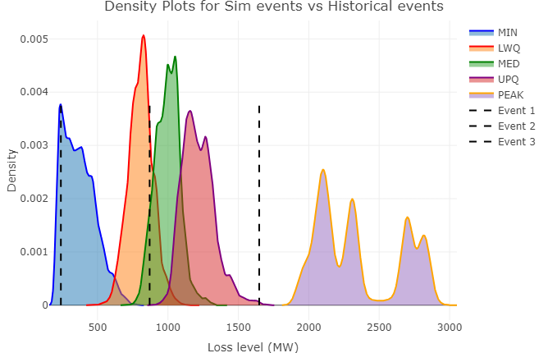
Data Source & Assumptions
Slido code #FRCR
Event Probability
10. Event Probability – Simultaneous Event Probability
Likelihood of medial simultaneous events:
$$\sum_{All events}{Prob(Loss of the event≥Median sim event profile)}$$
Likelihood of upper quantile simultaneous events:
$$\sum_{All events}{Prob(Loss of the event≥Upperquantile sim event profile)}$$
Likelihood of peak quantile simultaneous events:
$$\sum_{All events}{Prob(Loss of the event≥Peak sim event profile)}$$
Event 1 occurred on 23/08/2024 with combined loss of 240MW.
Event 2 occurred on 12/05/2024 with combined loss of 870MW.
Event 3 occurred on 22/12/2023 with combined loss of 1648MW.
Sim event | Minimum | Lower quantile | Median | Upper quantile | Peak
Event 1 | 0.13 | 0 | 0 | 0 | 0
Event 2 | 1 | 0.78 | 0.07 | 0 | 0
Event 3 | 1 | 1 | 1 | 0.99 | 0

Slide 30
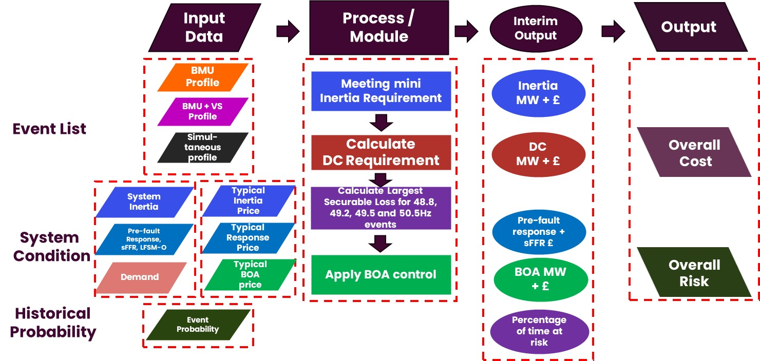
Slido code #FRCR
End of the Content

Slide 31
Previously Asked Questions
Slido code #FRCR
Q: There's things we can do in FRCR 2025 & probably quite a lot on time & resource reasons we can't. good to "get ahead of the game" for FRCR 2026, 27.. especially 2029&2030. What's the inertia trajectory, FRCR risk evaluations& frequency & grid forming services that complement? what should we start now?
A: Thanks for sharing your thoughts. The current FRCR methodology use immediate historical dataset including system outturns and market prices and adjust for expected changes for upcoming 2 years. The data is not a good representation for future system or market development. Therefore, FRCR recommendation does not forecast or indicate any long-term operation policies. However, the concerns are aware by us. NESO teams, e.g. longer term operability, zero carbon operation, market strategy who are collaborating to seek a better approach to address future challenges and create the framework that the whole industry can work together to tackle the challenges.
Q: What were stakeholder questions and feedback in previous years and what were the NESO responses ? Have these feedbacks been reviewed again to ensure that any issues have been considered and addressed?
A: Thanks for the question. Since 2024 FRCR project following running the consultation we published all the feedbacks and NESO responses on NESO website. We will continue publishing them this year and be transparent with industry. Before 2024 although we did not publish the full details of feedback from consultation, we would have individual engagement following their comments and would update the FRCR report based on the feedback. The comments which might not need immediate modelling consideration we would include them into future work that is in the end of the report. When starting a new FRCR process, we will review the feedback in the backlog to form the project scope. The scope is also shared with SQSS panel, Ofgem and industry via OTF.

Slide 32
Previously Asked Questions
Slido code #FRCR
Q: where will you get more inertia from if you don't want to run CCGTs and you haven't brought forward your T-4 and daily inertia mkts?
A: We need to meet the minimum inertia requirement which is set in the policy. That mean we need to run CCGTs to meet this requirements if necessary. The long-term and short-term inertia markets, i.e. T-4 market and intra day or day-ahead market are under developing aiming for bring more certainties to real-time operation and eventually reduce cost.
Q: FRCR focuses on cost reductions, what about carbon? Inertia decrease could lead to large carbon emission reductions despite a small cost reduction for the ESO. Could you provide metrics on that?
A: Carbon reduction is not a direct measure in FRCR policy. Running system at lower inertia level significantly reduces carbon emission as well as cost benefits. Practically the issue is addressed by the introduction of the stability path-finder work, Stability market and the development of Grid Forming techniques which are already part of the GB Grid Code and is being reviewed on a regular basis. Grid Forming enables converter-based plant (a lot of which are used in renewable technologies) to contribute system strength and inertia which will prevent the need to run carbon based plant.

Slide 33
Previously Asked Questions
Slido code #FRCR
Q: How will you desite to make Grid Forming now mandatory for all Type D generators (Renewables) from Jan.2026? how will this impact FRCR going forward as all a-sync. assets will have stability parameters?
A: This issue is being addressed through the GB Grid Forming Best Practice Group, part of which is to consider the requirement for a mandate. If you are interested in joining this group please use contact Hazem Karbouj (Hazem.Karbouj@uk.nationalenergyso.com) and we will be happy to add you to the group. It should also be noted that in Europe (ENTSO-E) they are also proposing to mandate Grid Forming on any plant of 10 MW and above or connected via a feeder of 110 kV or above. Changed following the mandating will be considered into future FRCR work.
Q: Please confirm that your answer to my previous question on Cybersecurity, is that there is no risk, because of grid code requirements. Correct?
A: Cybersecurity and its impact to power system is a big risk topic which is under discussion with the industry led by DESNZ. NESO’s input into this work is to ensure all the directions we are going to would not deteriorate existing system performance or security. For FRCR, we will consider this risk into future model once it is well clarified and structured. Out of FRCR cycle, if we see a risk becomes materialised NESO will introduce appropriate operational measures to mitigate before a proper policy is developed.
Q: In the methodology, has FSM response from renewable generation and battery energy storage has been considered?
A: As part of the modelling LFSM-O operation has been considered. FSM or MFR is not considered in the model. Commercial response services like DC, DR, and DM are the main sources for frequency control and when providing D, DR and DM services, FSM response is overridden by fast-acting dynamic response.

Slide 34
Previously Asked Questions
Slido code #FRCR
Q: GC0155 relating to FRT clarification remains un-concluded. Do we have a clear understanding for how much generation would be at risk of post fault overvoltage trip relating to this current uncertainty, and whether this risk is growing over time? again a question of margins in the model assumed.
A: Our interpretation of the Grid Code is that the oscillations arising due to a fault is covered by fault ride through requirements even when it includes a temporary overvoltage. So far, we have not seen limited cases when a PPM response to a fault has caused an overvoltage at the turbine terminals and caused the turbines to deload. This has not been a widespread issue and the risk associated with it is managed through the compliance process.
Q: How is inertia measured in real-time?
A: In NESO’s current operation practice we do not directly measure inertia. In real-time operation, system inertia is composed of the inertia from synchronising plants, the inertia contribution from synchronising elements on demand side and the inertia from pathfinder units. A synchronising plant’s inertia is calculated based on its running mode in real time and the inertia factor that is submitted to NESO via compliance process. The demand inertia is estimated by a demand inertia factor that is derived based on historical frequency events. We continue monitoring system inertia following frequency events and update the demand inertia factor to ensure it best represents system condition. We are also running innovation projects to validate our assumptions on demand side inertia. We will be able to measure system inertia in real-time and use the data for operation decisions once we have confidence on the outcomes from the innovation projects.

Slide 35
Join at slido.com #FRCR
ⓘ Start presenting to display the joining instructions on this slide.

Slide 36
Do you feel more confident in your understanding of FRCR after these webinars?
ⓘ Start presenting to display the poll results on this slide.

Slide 37
Were there any parts of the content that you feel needed further information or clarity on the topic?
ⓘ Start presenting to display the poll results on this slide.

Slide 38
What else would you like NESO to do to help you understand this topic?
ⓘ Start presenting to display the poll results on this slide.

Slide 39
Audience Q&A
Slido code #FRCR

Slide 40
Thank you for attending
Slido code #FRCR
Further reference: FRCR Methodology 2021
FRCR 2025 Webinar-1: Framework and Methodology (webinar slides and recording)
Webinar-2 slides are available on NESO website. Recording will be published after the webinar. A full Q&A document will be published by Friday 20 December that includes all Q&As from FRCR Webinar-1 and 2.
Please contact box.sqss@nationalenergyso.com for feedbacks and other questions

