Slide 1
Workgroup 8 Monday 29 April 2024
Online Meeting via Teams
CMP430/431

Slide 2
WELCOME

Slide 3
Expectations of a Workgroup Member
Contribute to the discussion
Be respectful of each other’s opinions
Language and Conduct to be consistent with the values of equality and diversity
Do not share commercially sensitive information
Be prepared - Review Papers and Reports ahead of meetings
Complete actions in a timely manner
Keep to agreed scope
Email communications to/cc’ing the .box email
Your Roles
Help refine/develop the solution(s)
Bring forward alternatives as early as possible
Vote on whether or not to proceed with requests for Alternatives
Vote on whether the solution(s) better facilitate the Code Objectives

Slide 4
Objectives and Timeline
Deborah Spencer – ESO Code Administrator

Slide 5
Objectives
Introductions
Action Review
Workgroup Consultation Responses
Legal Text Update
Next steps

Slide 6
Action Update
Deborah Spencer – ESO Code Administrator

Slide 7
Action Review
5 | WG2 | Proposer | Consider if there is any insight available into impact of Triads over winter 2023 and if this has changed following implementation of the Targeted Charging Review (TCR) | WG3 | Open
6 | WG3 | Proposer | To speak with Ofgem about possible data available through previous RFI | WG4 | Open
9 | WG3 | Proposer | To meet with Ofgem and MHHS Programme about the interacting timescales and the certainty needed around the Legal Text | WG4 | Open
10 | WG4 | Proposer/ HB | To meet with HB to consider the scenarios for contracts from October. | WG5 | Open
12 | WG5 | Proposer/ Elexon Representatives | CUSC Section 14 changes 14.17.41. To consider if a further table is required to include export. | WG6 | Open
13 | WG6 | Ofgem Representative | To discuss with Elexon about the information that was provided through DCD414 process in respect of CT/VT sites. | WG7 | Open
14 | WG6 | DH (ESO SME) | To conduct and analysis on the profiles for 5 to 8 | WG7 | Open

Slide 8
Workgroup Consultation Responses
All

Slide 9
Summary of the 5 non-confidential responses for CMP430
Q1 - Do you believe that the Original Proposal and/or any potential alternatives better facilitate the Applicable Objectives?
Three respondents believed that CMP430 Original Proposal better facilitated the objectives.
One respondent was neutral to objectives a, b, c and d, but replied negative for e.
Two respondents replied the Original Proposal objectives a, b, c and e better facilitated the applicable objectives. one respondent advised they were not able to judge against objective d.
One respondent advised that a, b and e of the Original Proposal better facilitated the applicable objectives.
One respondent made no comment.
Q2 - Do you support the proposed implementation approach?
All respondents were supportive of the implementation approach.
Q3 - Do you have any other comments?
One respondent suggested a three month minimum lead time to implement changes.
One respondent noted they were disappointed that it had taken the Proposer so long to raise a change to reflect the know impacts of MHHS.
Another responded noting that the lack of a reliable estimate of the number of customers impacted and the timeliness/availability of relevant data to suppliers to correctly price customers in the future will lead to inefficient outcomes.
Q4 - Do you wish to raise a Workgroup Consultation Alternative Request for the Workgroup to consider?
None of the respondents wished to raise a Alternative request.
Q5 - Do you agree with the Workgroup’s assessment that MOD430 does not impact the Electricity Balancing Regulation (EBR) Article 18 terms and conditions held within the CUSC
Two respondents agreed with the Workgroups assessment, one respondent noted they were unable to make a judgement, and all other respondents made no comment.
Q6- Do you have any comments on the impact of MOD430 on the EBR Objectives?
Two respondents made no comment, two respondents felt there was no impact, and another respondent felt they were unable to make a judgement.

Slide 10
Summary of the 5 non-confidential responses for CMP430
Q7- Does the Original Proposal have an impact on your business and if so, to what extent? e.g., Consumers treated differently in new arrangements?
Three respondents advise that their business would be impacted by the Original Proposal.
One respondent advised there would be minimal impact other than making changes to systems allowing correct billing of customers.
One respondent advised that although there would be no impact to their business they did not agree with the differentiation for domestic and non domestic unmetered customers.
Another respondent advised that there is expected to be a financial impact to their business from this change which is currently difficult to estimate. Financial impacts (if material) will be a one off on the initial implementation of the Proposal.
One respondent made no comment.
Q8- Does the Original Proposal have an impact on the systems and processes used by your organisation, and if so, to what extent? e.g., pricing, billing, settlement
Three respondent confirmed that their systems and processes would be impacted by the change
One respondent made no comment and one respondent confirmed they would not be impacted.
Q9- Do you agree with the scenarios identified that could be subject to different charging arrangements as a result of CMP430?
One respondent noted that as all unmeted customers will be HH by end of March 2025, the line in Annex 4 was confusing, adding, the table uses the term Current Charging Arrangements Pre MHHS migration and quotes a current MC=B. By April 2025. there will not be any MC=B as all unmetered (Domestic and Non-Domestic) will have all moved to MC=D. The table should be showing the position in April 2025 (the beginning of the charging year), where Domestic unmetered is MC=D and Triad moving to Triad.
Two respondents agreed, two respondents did not agree and one respondent made no comment
Q10- For suppliers only: How many sites does your organisation supply in the following scenario:
Four respondents made no comment.
One respondent highlighted b) Sites that are settled as Measurement Class A pre-MHHS migration that will have a Connection Type Indicator = L or H (meaning they are CT Metered) and a Domestic Premises Indicator = False post -MHHS migration, but made no further comment.
Q11-Do you agree that the Original Proposal should be considered as enduring, or do you believe should it be time limited – e.g., Linked to Market Wide Half Hourly Settlement Milestones?
Four respondents agreed that the Proposal should be enduring and one respondent felt the proposal should be time limited.
Q12-Do you agree that the Original Proposal will not impact the delivery of the MHHS Programme delivery Milestones?
Four respondents agreed there would be no impact and one respondent made no comment.

Slide 11
Summary of the 1 non-confidential responses for CMP431
Q1 - Do you believe that the Original Proposal and/or any potential alternatives better facilitate the Applicable Objectives?
The respondent agreed that CMP431 Original Proposal better facilitated the objectives b and d.
Q2 - Do you support the proposed implementation approach?
The respondents was supportive of the implementation approach.
Q3 - Do you have any other comments?
The respondent made no comment
Q4 - Do you wish to raise a Workgroup Consultation Alternative Request for the Workgroup to consider?
The respondent did not wish to raise a Alternative request.
Q5 - Do you agree with the Workgroup’s assessment that MOD431 does not impact the Electricity Balancing Regulation (EBR) Article 18 terms and conditions held within the CUSC
The respondent agreed with the Workgroups assessment.
Q6- Do you have any comments on the impact of MOD431 on the EBR Objectives?
The respondent made no comment.
Q7-Do you believe any additional definitions or changes to existing CUSC definitions are required as a result of CMP430 or CMP431
The respondent advised that Depending on the approach adopted CMP430 for legal text the Workgroup may wish to consider the introduction to CUSC on the introduction of “Domestic Premises” as a stand alone term or reference to BSC / Supply Licence.

Slide 12
Legal Text Update
Proposer – ESO

Slide 13
Market Wide Half Hourly Settlement (MHHS)
CMP430/431 – Legal Text (new approach)
Keren Kelly and Neil Dewar

Slide 14
Agenda
New Approach – Describing Changes to Charging and Non-Charging Arrangements
Discussions
Next steps

Slide 15
New Approach - Describing Changes to Charging and Non-Charging Arrangements

Slide 16
Legal Text approach for CMP430 (CUSC S14)
Previous feedback was that we could not introduce new terms and definitions to CUSC that had not been approved – i.e. Link to BSC (MC, CTI, DPI) in S11 and S14 was too complicated and confusing
ESO developed 3 new approaches for legal text based on feedback:
New Approach 1 – Describing changes to Charging, Non-Charging and BSC arrangements
New Approach 2 – Describing charging Arrangements without newly defined terms
New Approach 3 – Describing changes to Charging and Non-Charging Arrangements
ESO met with Ofgem and ESO Legal team last week to go through approaches before bringing these to you today
New Approach 1 was discounted as not viable and resulted in the same concerns seen previously and would likely lead to “send back”
New Approach 2 could work but has not been subject to legal review so have not shared this with you today
New Approach 3 has been subject to ESO Legal review and is the preferred approach but potentially needs refining (less is more)
Approach principle is based on explaining to CUSC Parties what changes as a result of transitioning to the MHHS arrangements – Annex 4 from the Consultation
Introduce new section to CUSC S14 and explain the change in charging arrangements in the highlighted boxes
Whilst we cannot introduce slide, we are able to add a guidance to CUSC

Slide 17
CMP430 Proposed TNUoS Charging Arrangements pre and post MHHS Migration of an MPAN
Domestic Premises Indicator | Connection Type Indicator | Current Measurement Class (non-MHHS) | Current Charging Arrangement Pre MHHS Migration | Proposed Charging Arrangement under CMP430 Following MHHS Migration | Derived MHHS Measurement Class
Domestic (T) | W (Whole Current); L (LV with Current Transformer); H (HV with Current Transformer) or E (EHV with Current Transformer) | A | 4pm – 7pm | 4pm – 7pm | F
 |  | F | 4pm – 7pm | 4pm – 7pm | F
 |  | C | Triad | 4pm – 7pm | F
 | U (Unmetered) | B | 4pm – 7pm | Triad | D*
Non- Domestic (F) | W (Whole Current) | G | 4pm – 7pm | 4pm – 7pm | G
 |  | A | 4pm – 7pm | 4pm – 7pm | G
 | L (LV with Current Transformer) | C | Triad | Triad | C**
 |  | E | Triad | Triad | C**
 |  | A | 4pm – 7pm | Triad | C**
 | H (HV with Current Transformer) | C | Triad | Triad | C**
 |  | E | Triad | Triad | C**
 |  | A | 4pm – 7pm | Triad | C**
 | E (EHV with Current Transformer) | C | Triad | Triad | C**
 |  | E | Triad | Triad | C**
 | U (Unmetered) | D | Triad | Triad | D
Triad = Chargeable Demand Locational Capacity
4pm – 7pm = Chargeable Energy Capacity
Yellow highlight shows possible change in TNUoS charging as a result of CMP430
*All NHH Unmetered (Measurement Class B) will be transferred to Measurement Class D by the start of the migration period. N.B. Measurement Class B is currently charged 4pm-7pm and reason for change is as a result of the implementation of P434. Whilst theoretically possible, the expectation is that there will be no Domestic Unmetered demand.
**Measurement Class C will contain the sum of Measurement Classes C and E for Migrated MPANs. This will have no charging impact as both Measurement Class C and E are charged Triad
Measurement Class A is non Half Hourly Metered which will include Domestic and Non-Domestic and a variety of different Connection Types. The table highlights future treatment depending on different combinations

Slide 18
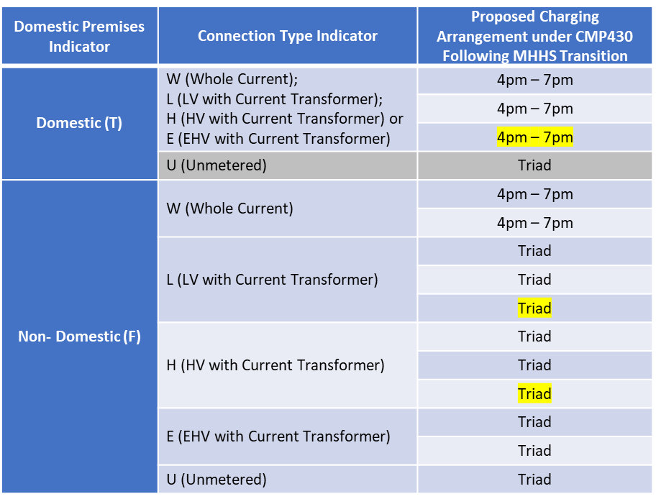
Suggested Guidance note to add to CUSC for CMP430

Slide 19
Suggested Legal Text for CMP431 (CUSC S11)
Minimal Definitions required under this approach
Domestic Premises could be defined using reference to the BSC or Supply Licence
If it is established no changes required to S3 or S11 of CUSC, CMP431 could be withdrawn

Slide 20
Suggested Legal Text for CMP430 (CUSC S14)
This section describes how Meters will be charged from M11 of MHHS Implementation as defined in the Balancing and Settlement Code (Section C12.1.1), further defined in (Section C12.2.9) and outlined in the Authority’s decision dated 12 June 2023.
14.17.41.1 For the relevant Charging Year until the specified Meter Point Administration Number(s) (MPAN) is subject to transition to the MHHS Target Operating Model as defined in the Balancing and Settlement Code 12.2.24, it will continue to be charged TNUoS using the existing Charging arrangements
14.17.41.2 From the relevant point during the Charging Year that the specified Meter Point Administration Number(s) (MPAN) transition(s) to the MHHS Target Operating Model, as defined in the Balancing and Settlement Code 12.2.24 it will be charged TNUoS using the existing Charging arrangements, except in the following circumstances:
When an MPAN with a NHH Metering System transitions to a HH Metering System with current transformer at a non-Domestic Premises and is reported as such from BSCCo to the Company, it will be treated as Chargeable Demand Locational Capacity
When an MPAN with a HH Metering System transitions to a HH Metering System with whole current or current transformer at a Domestic Premises [as defined in the Balancing and Settlement Code] and is reported as such from BSCCo to the Company, it will be treated as Chargeable Energy Capacity
14.17.41.3 Should an Meter Point Administration Number (MPAN) be subject to reverse migration during the timelines, of the MHHS Implementation Timetable, as defined in the Balancing and Settlement Code, Section C12.2.11, it will revert to be charged TNUoS according to 14.17.41.1 until such time that the MPAN is re-introduced to the MHHS Target Operating Model, whereby it will be charged TNUoS according to 14.17.41.2

Slide 21
AOB/Next Steps
Deborah Spencer – ESO Code Administrator

Slide 22
Timeline for CMP430 – Updated after CUSC Panel (23 February 2024)
Milestone | Date | Milestone | Date
Modification presented to Panel | 23 February 2024 | Code Administrator Consultation (6 working days) | 10 June 2024 to 14 June 2024
Workgroup Nominations (4 Working Days) | 23 February 2024 to 29 February 2024 | Draft Final Modification Report (DFMR) issued to Panel (4 working days) | 24 June 2024
Ofgem grant Urgency | 29 February 2024 (5pm) | Panel undertake DFMR recommendation vote | 28 June 2024
Workgroup 1 to 7 (assuming Ofgem have granted Urgency) | 06 March 2024 11 March 2024 13 March 2024 – cancelled 19 March 2024 28 March 2024 05 April 2024 15 April 2024 17 April 2024 | Final Modification Report issued to Panel to check votes recorded correctly | 28 June 2024
Workgroup Consultation (5 working days) | 17 April 2024 – 24 April 2024 | Final Modification Report issued to Ofgem | 28 June 2024
Workgroup 8 to 14 - Assess Workgroup Consultation Responses and Workgroup Vote | 29 April 2024 03 May 2024 – cancelled 08 May 2024 13 May 2024 20 May 2024 24 May 2024 30 May 2024 | Ofgem decision | 30 September 2024
Workgroup Report issued to CUSC dot box Workgroup Report presented to Special Panel (Panel agree Workgroup report has met its Terms of Reference) | 03 June 2024 07 June 2024 | Implementation Date | 01 April 2025

