Slide 1
Charging For Active Network Management / Flexible Connections
Webinar - 15 May 2019
The Webinar will begin Shortly

Slide 2
Webinar Aims
To provide you with:
- an update on our work
- an explanation of our proposals
- opportunity to ask questions/challenge
- an overview of next steps

Slide 3
Background
Ofgem asked DNOs to jointly review the principles for connection charging for Active Network Management (ANM) schemes.
The existing Common Connection Charging Methodology (CCCM) was developed against a backdrop of traditional engineering assets.
The CCCM includes rules for the apportionment of asset reinforcement costs (where shared assets are swapped-out for larger ones)
In contrast ANM/flexible connections avoid the need for reinforcement by sharing available headroom and utilising existing assets closer to their maximum operating parameters.
ANM/flexible connections use advanced smart grid technology with their own costs.

Slide 4
Developing Common Charging Principles
“… compliance with the methodology results in charges which reflect, as far as is reasonably practicable (taking account of implementation costs), the costs incurred by the licensee in its Distribution Business”
What are the costs?
Capital costs of connection
Enduring running costs
How should costs be allocated?
Recognition of wider benefits
Different treatment of capital costs associated with different scheme types?
Different treatment of enduring O&M costs to those applied to existing ‘standard’ connections?

Slide 5
Recognising ‘flexible’ can be Minimum Scheme
“The Minimum Scheme is the Scheme with the lowest overall capital cost (as estimated by us), solely to provide the Required Capacity.”
Customers now have choices to request and accept less than 24/7 capacity continuity via a flexible connection
Required Capacity can therefore both be defined both in MW and the extent to which customers are prepared to be flexible.
Customer can still choose 24/7 continuity and in such circumstances the Minimum Scheme will not be a flexible connection and will include reinforcement.

Slide 6
Defining types
The following categorisation of ANM is proposed:
Type 1 – Dedicated ANM: A flexible connection/ANM scheme managing constraint(s) where there are no customers downstream of the constraint(s) who could connect new or additional generation without being controlled by the ANM scheme
Type 2 – Wide Area ANM: An ANM scheme managing constraint(s) where there are customers downstream of the constraint(s) who could connect new or additional generation without being controlled by the ANM scheme
The key difference is that the Type 1 scheme only benefits specific participants (no wider benefits) whilst Type 2 enables other diverse users to operate un-curtailed (providing wider benefits)

Slide 7
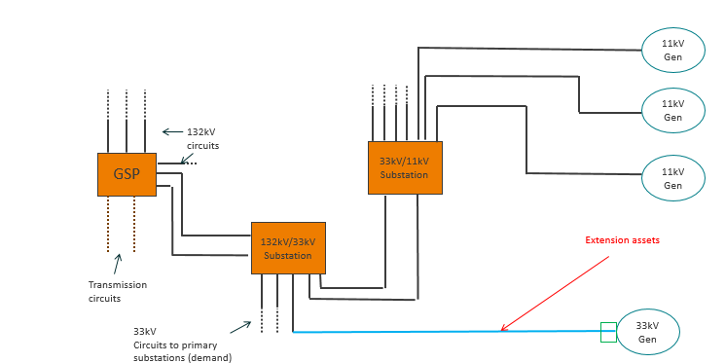
Single Customer without ANM

Slide 8
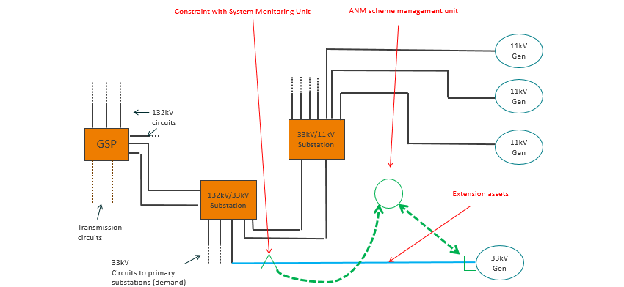
Type 1: Dedicated Single Customer ANM

Slide 9
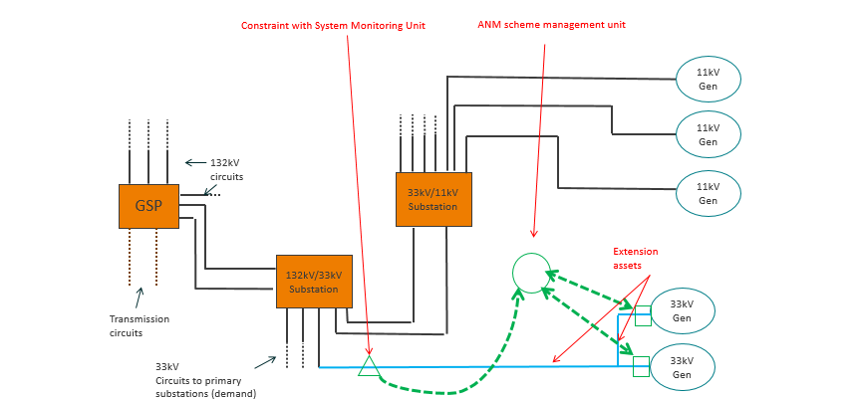
Type 1: Dedicated Multiple Customer ANM

Slide 10
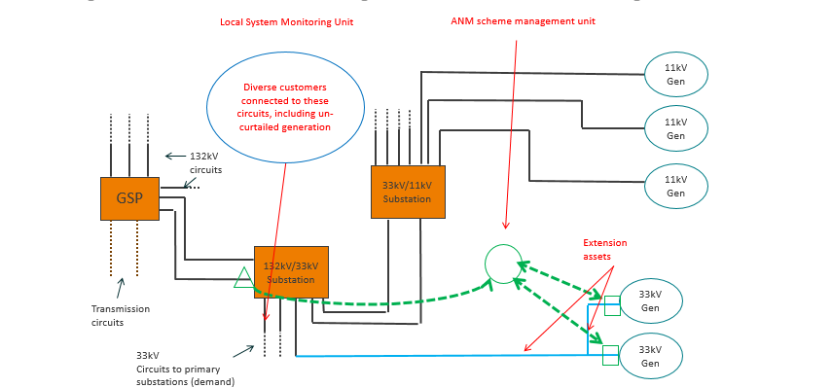
Type 2: Wide Area ANM (Simple)

Slide 11
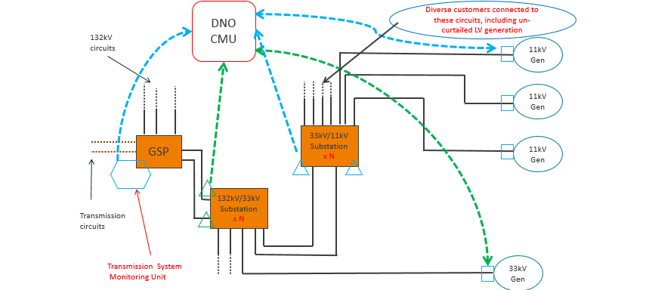
Type 2: Wide Area ANM (Complex)

Slide 12
ANM Charging – Proposed Cost Recovery
Cost Components | Type 1 Single | Type 1 Multiple | Type 2 Wide Area
Capital
Customer extension assets | Charged individually | Charged individually | Charged individually
End user control unit | Charged individually | Charged individually | Charged individually
Local system management unit | Charged individually | Shared between participants | Recovered via DUoS
Scheme management unit | Charged individually | Shared between participants | Recovered via DUoS
Central Management unit | N/A | N/A | Recovered via DUoS
Enduring O&M
Communications, licensing, other | Recovered via DUoS | Recovered via DUoS | Recovered via DUoS

Slide 13
Next Steps
Take on board feedback from today
Conclude drafting of proposed changes to Common Connection Charging Methodology
Present proposals to ENA Open Networks Steering Group – June 2019
Submit DCUSA Change Proposal - June/July 2019

