Slide 1


Customer Requirement Playback
EMR Portal - 20th October 2022

Slide 2


Introduction
Exhibit Generation
Outstanding Activities
Document Upload
Enhanced Cloning
Continuing the Conversation
Contents

Slide 3
Introduction – Context for today
Requirement playback sessions will summarise proposed “Features” and what we intend to deliver prior to each development phase.
We have already used your feedback in setting requirements. There will be more opportunity for further feedback and familiarisation in future.
Your feedback will be incorporated where possible now or logged for future enhancements on our development backlog.
We have created design “mock-ups” to help visualise how the New Portal might deliver your needs. System demonstrations post development will present the actual system functionality.

Slide 4
Exhibit Generation
Feature Description
This feature relates to the Exhibit Generation; which is a process used by External Participants to produce Exhibits using the correct templates provided by the Delivery Body, in accordance with the Capacity Market Rules.
Customer Feedback Considered
Provide support to reduce the number of failures that are encountered due to incomplete/incorrectly completed Exhibits
Enable reuse for future PQ rounds of those Exhibits that Ofgem have considered as “Evergreen”
Help to enable and improve the process to pass Exhibits for Director e-signatures
Ensure that the correct version of an Exhibit is used
High-level Requirements Proposed
We have proposed the option for the system to display only templates relevant to a specified CMU type
We have proposed a solution which will prepopulate the chosen Exhibit with standard Applicant / Application details (i.e. Applicant Company Name, Address, CMU ID etc). Please note a user will still need to manually populate data fields which have not been prepopulated.
The introduction of Evergreen Exhibits has allowed us to propose a solution to highlight the relevant Exhibits that can be re-used. This solution will also highlight the length of time (years) that the selected Evergreen Exhibit may still be used.
We have proposed that an electronic exhibit can only be issued for e-signature(s) after all relevant / mandatory fields have been completed. User will still be given the option to manually complete an Exhibit.
We proposed the ability for an attached Exhibit to be removed from the relevant area (i.e. CMU, Application, Agreement, Company or User. This does not apply to submitted Applications)

Slide 5
Outstanding Activities
Feature Description
The Outstanding Activities view intends to show customers all date-driven obligations relating to their CMUs following prequalification with links to action these activities.
Obligations and activities that are not driven by a date will be shown through a separate feature
Customer Feedback Considered
Difficulty navigating the current portal and knowing if an activity is related to the My CMUs, My Agreements etc.
Milestone tracking across multiple agreements is currently not available in the existing portal so requires separate processes to understand and manage, supported by updated from the delivery body through reminders and the Customer Deadline Tool.
Reliance on emails to notify customers of obligations, these do not always go to the individual accountable for that process within the organisation.
High-level Requirements Proposed
A table showing all date-driven obligations and associated information
Links directly to the page where those obligations can be submitted
The assessment status of those obligations and any comments from the Delivery Body
By default we expect this to be sorted by date with the most pressing obligation appearing at the top
For more complex deadlines (e.g. emissions) we are considering how to manage dates that may be specific to different technologies
Ability to filter and search for a particular CMU, obligation, or auction We're interested to hear from you what fields you would like to see on this list and which of these you would like to filter/search/sort by

Slide 6
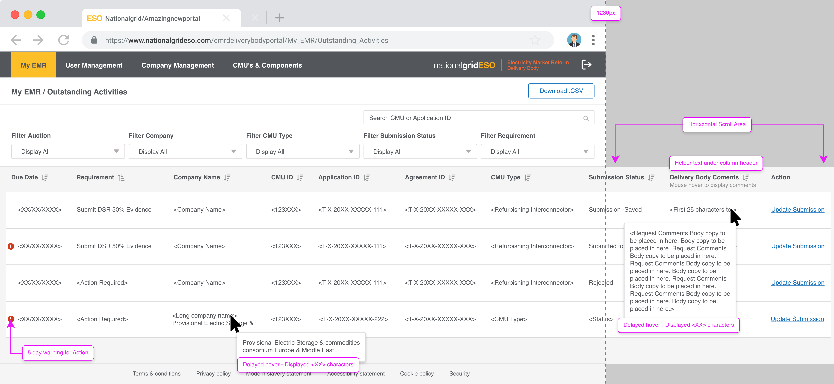
Outstanding Activities

Slide 7
Provision of Documents
Feature Description
For milestones that require document uploads (e.g. FCM) we must allow submission of these documents, any supporting declarations and capture any supporting data items
Customer Feedback Considered
Improved signposting so the upload location is clear (considered as part of Outstanding Activities)
View option for uploaded documents prior to submission
Zipped files make it difficult to check document uploads
Ability to upload documents against multiple agreements
High-level Requirements Proposed
Document uploads to be signposted through Outstanding Activities
Declarations and additional fields to appear standalone as required ideally with validation warnings
Multiple files can be added to the same area, removing the need for zipped files
File formats are explicit beside the upload button
Drag and drop uploads to be supported
Ability to view documents uploaded before submission
Investigating assigning documents to multiple applications and linked CMUs
History of past submissions available to view
Exhibits and standard templates can be managed through the Exhibit generator

Slide 8
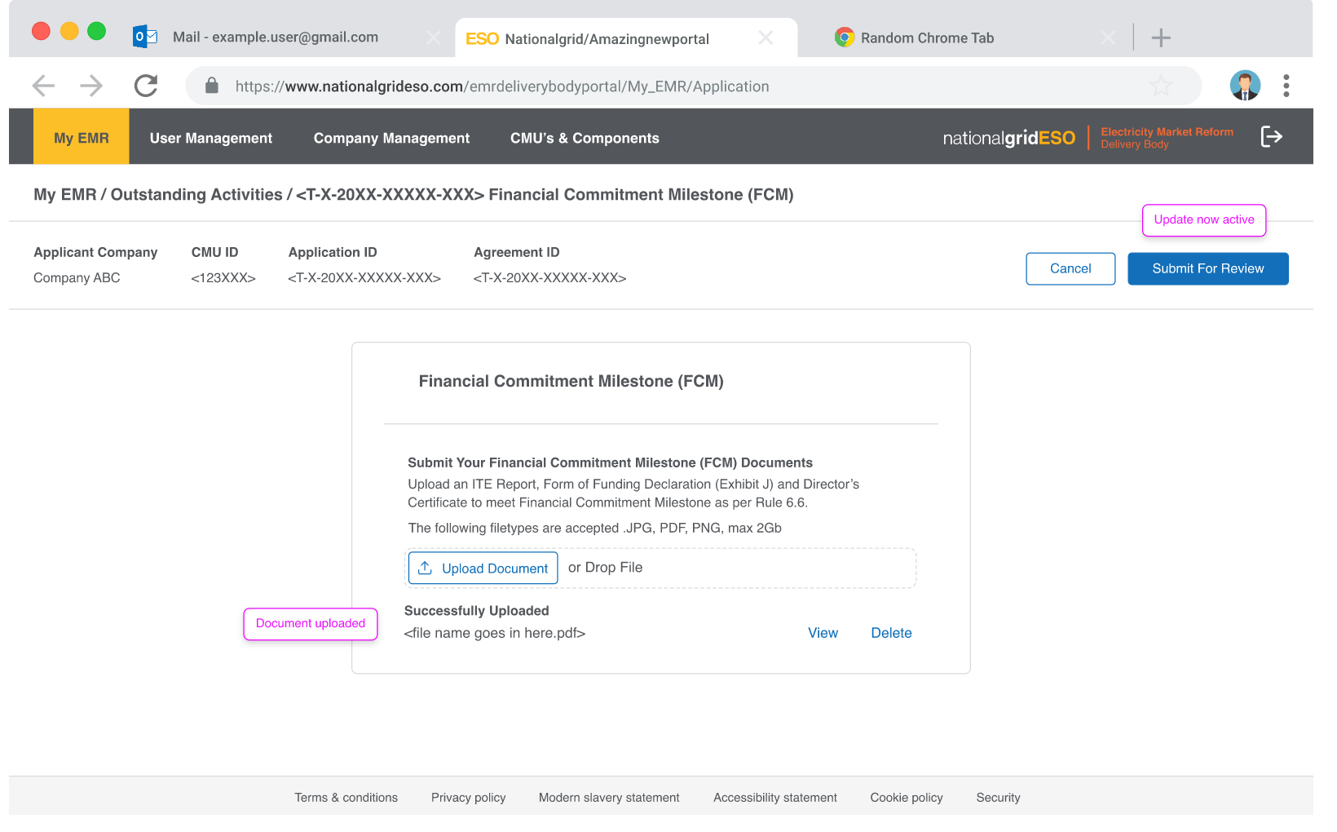
Document Upload

Slide 9
Enhanced Cloning
Feature Description
The Enhanced Cloning feature option is being developed to enhance the current Cloning process in the current EMR Portal based on feedback of the current process
Enable an easier method of Cloning requiring less administrative work attaching relevant Documentation
Reduction in requirement to Clone due to certain data elements being held at the CMU/Component level as well as requirements moved to Application level
Customer Feedback Considered
Current Cloning feature is difficult to manage and does not enable all requirements when cloning a CMU
Current Cloning Experience is frustrating and creates unnecessary challenges
No method of visibility of Cloned CMUs and relevant Parent CMU
Not possible to copy relevant documentation over to the Cloned CMU when conducting cloning process
High-level Requirements Proposed
Better visibility of Cloned CMUs and relevant link to original Clone for both External Parties and the Delivery Body
Document selection process being conceptualised with development team and Delivery Body to enable all or specific documents to be attached from the Parent CMU to the relevant Clone CMU
CMU which has been cloned can not be deleted until the relevant clone(s) have been deleted ensuring better management of a CMU portfolio
Functionality should enable a smoother experience when cloning relevant CMUs than existing process
Reduction in the administrative burden in required actions following the Cloning of a CMU
Where appropriate, the Delivery Body have also repositioned some features from the CMU to the relevant Application e.g. Emissions Exhibits. This reduces the number of instances where a clone is necessary.

Slide 10
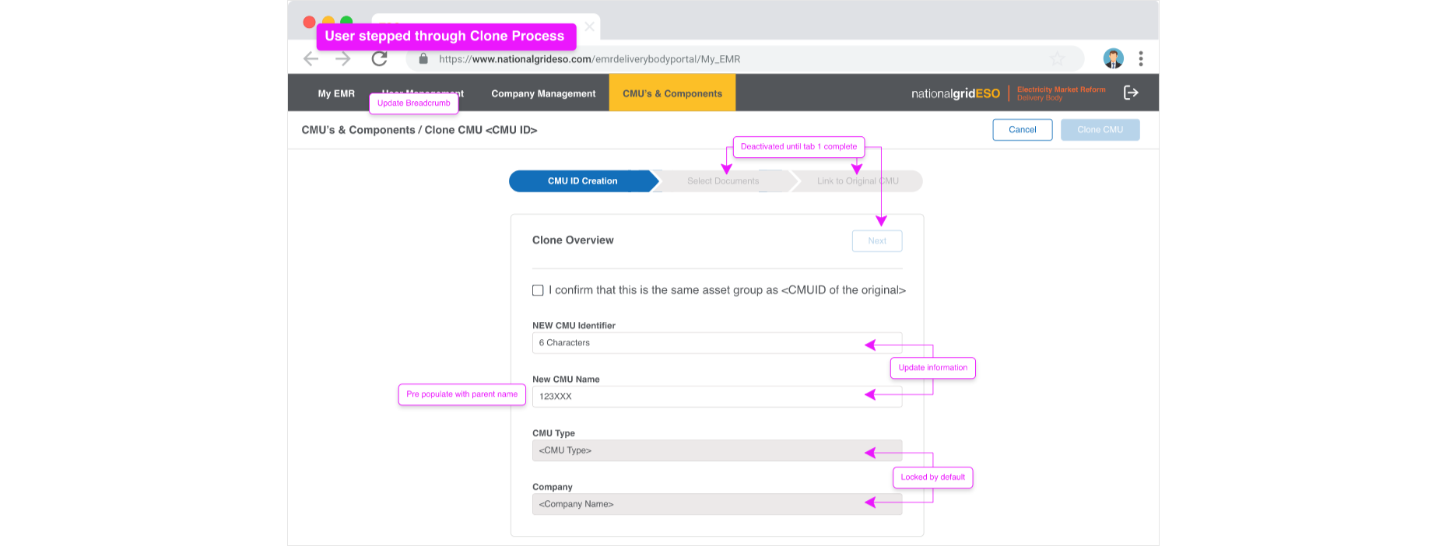
Enhanced Cloning

Slide 11
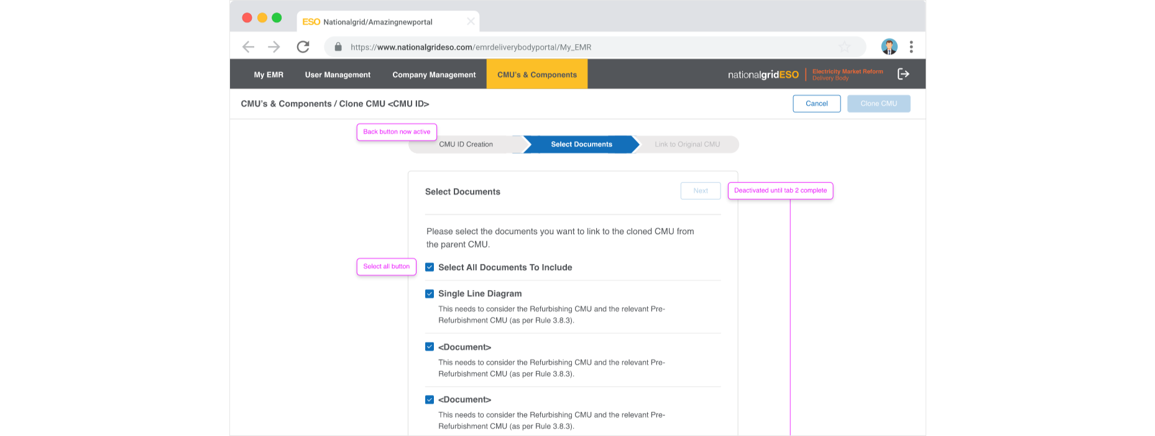
Enhanced Cloning

Slide 12
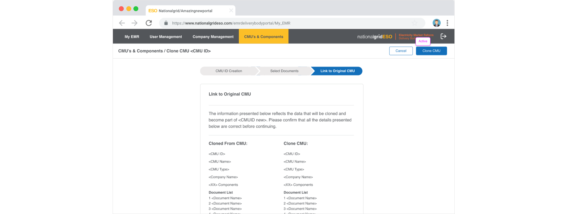
Enhanced Cloning

Slide 13
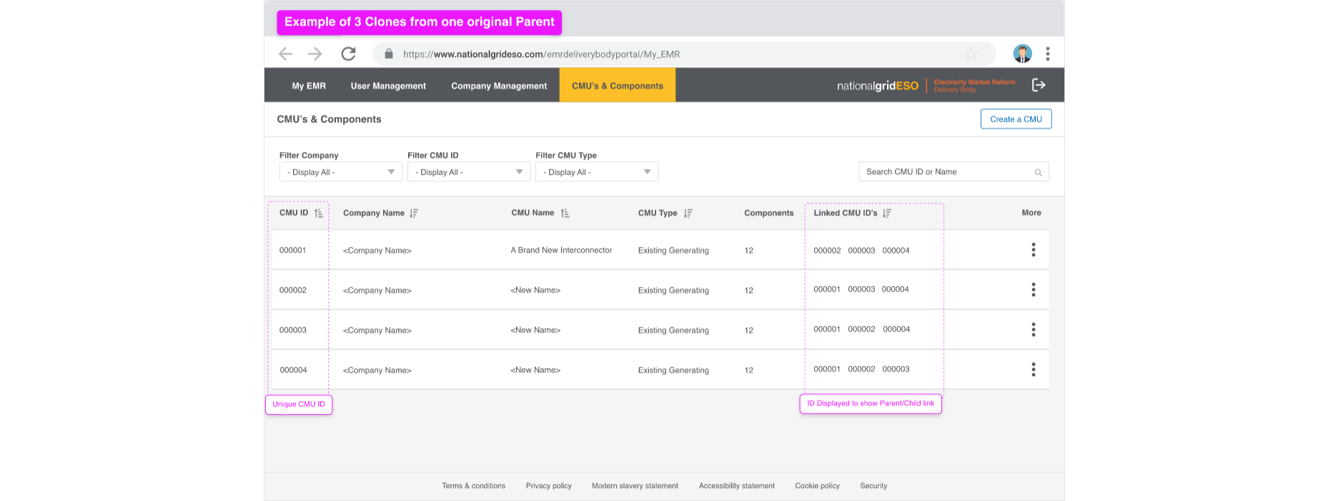
Enhanced Cloning

Slide 14
In addition to feedback received today, we are keen to hear from you with any additional feedback via Email box.newemr.itteam@nationalgrid.com
We would also love to hear your feedback on how we have presented the material today and any improvements we can make to playback requirements with you. Please contact me at
Richard.Griffiths@Nationalgrideso.com
We are happy to continue to engage with you further on the topics we discussed today and look forward to demonstrating the delivery of the requirements in the New Portal in future sessions.
We will hold our next Requirement Feedback session on 10th November
Continuing the Conversation

Slide 15
Appendix - Requirement process
The steps below summarise the overall requirement validation, confirmation and familiarisation process used.
Requirement playback sessions consider requirements currently sitting in Stage 1 of the process.
Our intent is to use Playback to support the initial requirements definition prior to them being passed to our development team/project backlog.
1. Requirement definition
2. Confirm requirement/ backlog
3. Show & tell/ Demonstration and capture feedback
4. Sandbox/ Testing
5. Implementation/ Customer readiness

