Slide 1
Digitalised Whole System Technical Code (dWSTC)
Project Status Update to DCRP – June 2022
Frank Kasibante

Slide 2
Project Timeline
May 2022
Scope is approved for Training & Guidance workstream
Letters sent to GCRP & DCRP
Dec 2021 Inaugural Steering Group Meeting
March 2022
Steering Group votes on way forward
April 2021
Project commissioned
June 2021
Ramping up of Stakeholder engagement
September 2021 Consultation Published
2022 – 2026
Delivery period
May 2021
Initial Stakeholder Engagement
August 2021
Draft Consultation Issued to Industry
Nov 2021 Consultation closed
Feb 2021
Consultation Responses Analysis published
April 2022
Scope is approved for Digitalisation workstream and Alignment, Simplification and Rationalisation (ASR) workstream
June 2022
DCRP & GCRP asked to write to Ofgem confirming the approved work
Notes:
Project Team set up – Initial contacts with industry – Broadcast approach taken to engage through forums, Bilateral meetings, Telephone calls, webinars – Feedback incorporated into Consultation draft and Consultation 1 Document – Published – Responses Analysed – Steering Group set up – Steering Group Vote – Scoping Documents – Delivery.

Slide 3
Project Workstreams Considered:
Alignment, Simplification & Rationalisation
Digitalisation of Grid Code
(Distribution Code Digitalisation to be considered)
Training & Guidance
Code consolidation – on hold pending progress on the BEIS/Ofgem Energy Code Reform work
SQSS governance – no support for now

Slide 4
Alignment, Simplification & Rationalisation workstream (ASR) Process
Detail of work
Identify manageable sections of the Grid Code.
Produce estimates and a plan to achieve goals in Alignment, Simplification and Rationalisation for each section.
Produce a common understanding of how the work will be done by the use of piloting.
Report progress and results to the Steering Group.
Step 1
appoint a project team from across industry
Detail of work
Step 2
setting up a formal dWSTC workgroup to cover each identified pilot section
Undertake activities identified by the project team which may need specialist knowledge.
Identify examples and work through practicalities.
Notes:
Glossary of terms:
1: Alignment
The process by which areas of the Distribution Code (and ERECs) and Grid Code that are not aligned, in intent or execution, are identified and then modifications to the relevant code panel are raised via the normal code governance process to correct these.
2: Rationalisation:
The task of streamlining undue detailed prescription and removing any irrelevant or outdated information.
3: Simplification
The task of translating code requirements (where possible) from technical prescriptions and legalese into plain
English and establishing outcome-based regulation into new rule design

Slide 5
2022 Timeline
Alignment, Simplification & Rationalisation workstream (ASR)
MAY
JUNE
JULY
AUGUST
SEPTEMBER
OCTOBER
NOVEMBER
DECEMBER
Summary of Proposed Implementation schedule for the ASR workstream
Draft outline plan,comments from Steering Group
Seek nominations and set up Project Team
Development and piloting phase
Project Team identifies suitable sections of the code(s), produces more detailed plan, develops pilot solutions and reports to Steering Group
SG Decision point
Consider further work
Notes:
Glossary of terms:
1: Alignment
The process by which areas of the Distribution Code (and ERECs) and Grid Code that are not aligned, in intent or execution, are identified and then modifications to the relevant code panel are raised via the normal code governance process to correct these.
2: Rationalisation:
The task of streamlining undue detailed prescription and removing any irrelevant or outdated information.
3: Simplification
The task of translating code requirements (where possible) from technical prescriptions and legalese into plain
English and establishing outcome-based regulation into new rule design

Slide 6
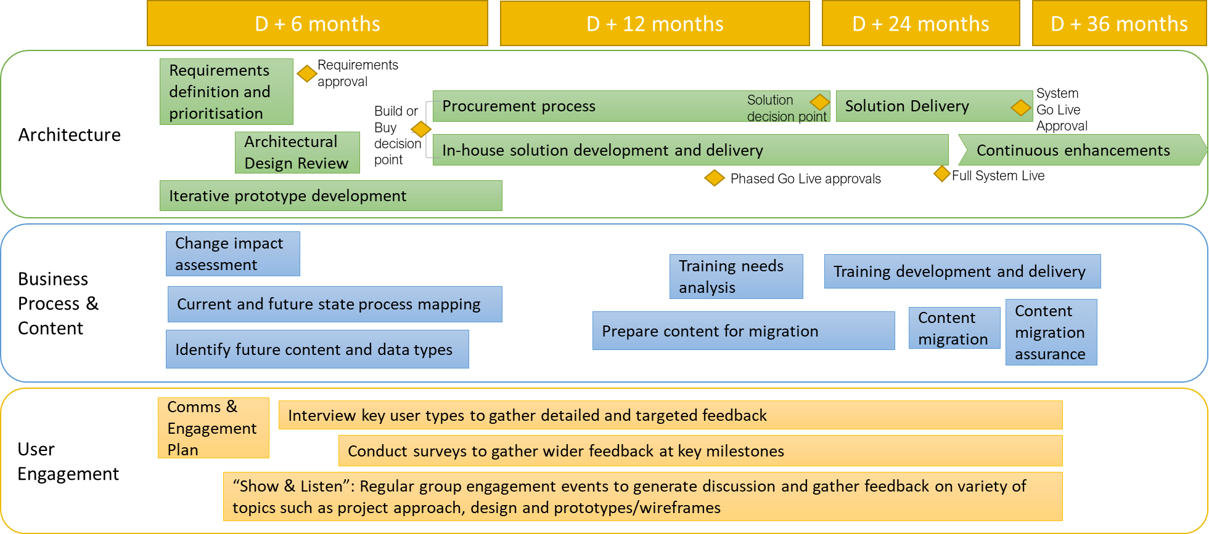
Digitalisation of Codes Overview Objectives and Timelines
Notes:
Outcome & Objectives derived from engagement and consultation feedback to date.
Achievement of these objectives will be ascertained through continuous stakeholder feedback.

Slide 7
Notes:
Concept: Multiple search criteria

Slide 8
Notes:
Concept: Scenario based filtering

Slide 9
Notes:
Concept: User guides to support understanding and navigation
Guidance & Training workstream will feed in new and existing content for future platform.

Slide 10
If you have any further questions, please contact the team at box.WholeSystemCode@nationalgrideso.com

