Slide 1
GC0117 Workgroup Meeting
Meeting date 25th October 2021

Slide 2
Agenda
Action Log
Review additional feedback on survey
Matrix on impacts for the thresholds
Open Networks - can this be an agenda item?
TNUoS- can this be an agenda item?
CBA update if we can
Legal Text thoughts
Consultation questions
Agree next steps

Slide 3
Action log
Review Action Log

Slide 4
Survey

Slide 5
Preference of Thresholds
Options to review | Advocate
10MW for Large (SHE) | Proposer and ESO
100MW for Large (NGET) (Status Quo) | Alan Creighton alternative
50MW | Survey responses
Other options | ?

Slide 6
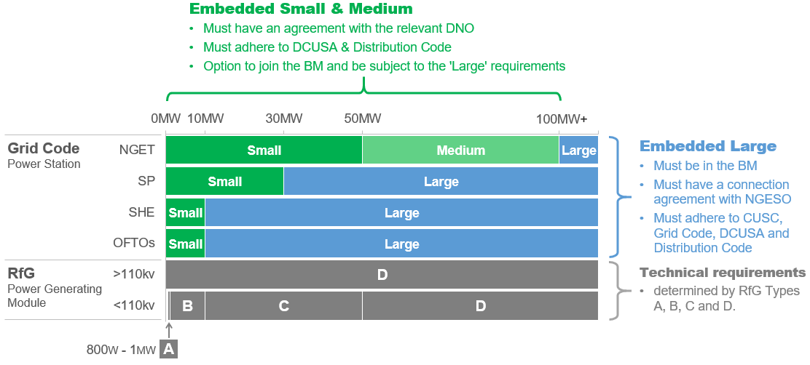
Preference of Thresholds
Current thresholds & obligations

Slide 7
Agree Next Steps

