Slide 1

#R2NZ4 SLIDO code
BREAKOUT SESSION
Contracts for Difference: short / longer
term issues & ESO actions
Laura Brock
Sarah York
Stefan Preuss
The webinar will start shortly.
Please make sure you are on mute and your camera is turned off.
Please note that the webinar will be recorded.

Slide 2
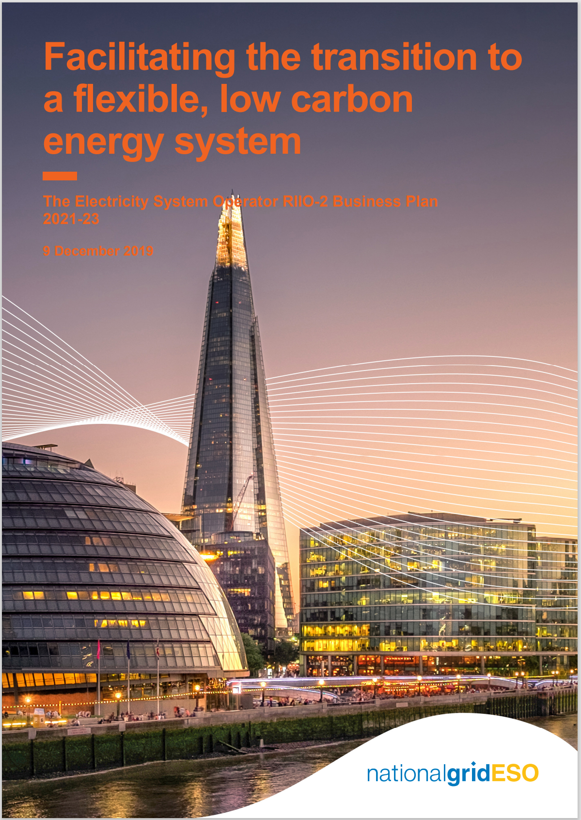



Contracts for Difference: Short / longer term issues and ESO actions
#R2NZ4 SLIDO code
Context
Now to 2025
Beyond 2025

Slide 3
The road to net zero electricity markets: other events
Tuesday 23rd March
Wednesday 24th March
Thursday 25th March
10am
1pm
10am
1pm
10am
1pm
The road to net zero electricity markets launch
Market reform insights
Code change roadmap to 2025
Electricity Market Reform: Capacity Market and Contracts for Difference
Net zero market design
DSO markets
Are you interested in finding out about how the electricity market is changing and progressing to a zero carbon grid?
The Markets team in the ESO are running a series of interactive, online events in March, where you will be able to take part in focused sessions with subject matter experts on different aspect of electricity market change.
Click here to find out more and register for the events or access the recordings if you can’t make the session.

Slide 4

We’d love to hear what you thought of the event.
Please contact us via email: emr@nationalgrideso.com​
#R2NZ4 SLIDO code

