Slide 1
C16 Consultation 20/21
5th November 2019
https://nationalgrid.onbrandcloud.com/login/

Slide 2
Contents
1 | Welcome
2 | Procurement Guidelines & FFR
3 | ABSVD
4 | BPS & SMAF
5 | NOA Pathfinders
6 | Interconnectors
7 | Next Steps

Slide 3
Introduction
This session is an early opportunity for us to tell you about the changes we are thinking of making to the statements in this years consultation
It’s also a great opportunity for you to tell us what you think about our suggestions and what else would you like to see
Goal of today is that we all have a clear idea of where change is being recommended and where the priorities should be.
This session is not to agree or finalise any changes but to have an open discussion.
As well as this informal consultation we will still need to carry out our formal process at the start of 2020.
We hope that our engagement with you and others today will mean that process is less pressured and results in better outcomes for all industry.

Slide 4
Introduction
This session is an early opportunity for us to tell you about the changes we are thinking of making to the statements in this year's consultation
It's also an early opportunity for you to tell us what you think about those changes and what else would you like to see
Goal of today is for both NGESO and Industry to come together and start some joined up thinking on the future of the C16 statements
This session is not to agree or finalise any changes but to open dialogue and to seek to understand
The standard consultation will still apply in January where more concrete decisions will be made

Slide 5
Procurement Guidelines
https://nationalgrid.onbrandcloud.com/login/

Slide 6
Firm Frequency Response and Procurement Guidelines
Proposed changes to Response services
Change frequency of tendering to monthly and weekly competitive tendering process
The change is to implement our commitment to closer to real time procurement, we are running weekly auctions for frequency products.
Removing quarterly procurement of Fast Reserve – only procured on month ahead from November 2019 (EGBL compliance).
Refresh list of procured response services
Changes required to reflect the new products that we are currently and will be looking to procure going forward
Remove FCDM and DTU products from the procurement guidelines
FCDM has been replaced with the competitively tendered Low Fast Static service, Demand Turn Up has stopped being procured, any replacement for this service will form part of the reserve reform work stream.

Slide 7
Firm Frequency Response and Procurement Guidelines
4. Ability to run adhoc tenders as required to meet system needs
Provide a more flexible tendering of requirements in addition to the monthly/ weakly tenders/ auctions.
5. Impact of EBGL and clean energy package on ancillary services (STOR / FR/ FFR )
Units with existing STOR and FR contracts, will need to submit utilisation prices in real-time.
After the 1st Jan utilisation prices for new contracts will not be pre-agreed.

Slide 8
Firm Frequency Response and Procurement Guidelines
7. Review of procured volumes and tendering frequency for Fast Reserve
Analysis being done to review what our requirement is.
Main change in the PG for STOR is the removal of the reference to buying 3 times a year
CEP states we must move to day ahead procurement.
At this stage, we don’t know what the exact change will be, but changing the wording to “As Required” gives us the flexibility to choose what frequency of procurement is correct.

Slide 9
ABSVD
https://nationalgrid.onbrandcloud.com/login/

Slide 10
ABSVD
Potential ABSVD changes include P354 clarification:
Should long term STOR contracts (15yr, ending 01/04/25) signed before P354 was known about be excluded from P354 on the basis that recent tenderers have known P354 would be implemented – A limited number of sites with historical limited utilisation
In the Final Modification Report of P354, on page 47 it was noted that we stated our intention was to only amend contracts once they expire. The current STOR SCTs and ABSVD Methodology do not make any distinctions in the treatment of long and short term contracts
P354 was introduced on the basis that SVA sites would be ABSVD for Fast Reserve, STOR and DTU i.e non-BM however it transpires that a small number of sites technically classed as BM (and dispatched outside the BM) are also contracted for these services. For completeness should P354 also capture these small number of sites.
In addition, we are assessing internally any other changes that may be required.

Slide 11
SMAF & BPS
https://nationalgrid.onbrandcloud.com/login/

Slide 12
SMAF & BPS
Maxgen: Discussions with the Control Room have concluded that the MAXGEN service is still required due to the uncertainty around BREXIT and TERRE/Wider Access changes. Parties are requested to keep data updated with respect to available volumes and submitted prices
Change scope of BPS Audit to include the Use and Procurement of Balancing Services:The BPS audit does not review the contracting of STOR, Fast Reserve etc, instead concentrates on BM actions taken vs those not taken. BM STOR units are included in this analysis.
When a unit is taken for these services, they may be called off for other reasons not just prices. The reasons include response and recovery times, number of synchronisations per season as well as geographical location etc; BM units which provide these services are included in the analysis.
The Contracting of units for these services will be changing due to EU code changes. An Outline Change Proposal was published on the ESO Website. The consultation closed on Friday 1st November 2019, and we are looking through the responses.
SMAF: No changes are to be implemented to the report. However there are daily reports published on the ESO website which cover system actions and current constraints.

Slide 13
NOA Pathfinders
https://nationalgrid.onbrandcloud.com/login/

Slide 14
Accelerated loss of mains change programme (ALoMCP)
Context
Reduced running of synchronous generation is leading to a reduction in system inertia
Lower system inertia leads to frequency moving more quickly
£150 million spent in 2018/19 through BM and trading to prevent tripping of loss of mains protection
Progress
ALoMCP went live on 2nd October 2019 - c800 applications to date (c3.5GW)
Ofgem have approved DC0079 code change to enforce ROCOF relays / settings by Sept'22
Fixed payments made to generation owners to incentivise them to make the changes early
Will be paid for through BSUoS charges
Next steps
Procurement Guidelines - Update description in constraint management services to include protection changes as a method for managing a constraint
Reporting - Update MBSS / Procurement Guidelines Report to report costs separately to BM and trading costs

Slide 15
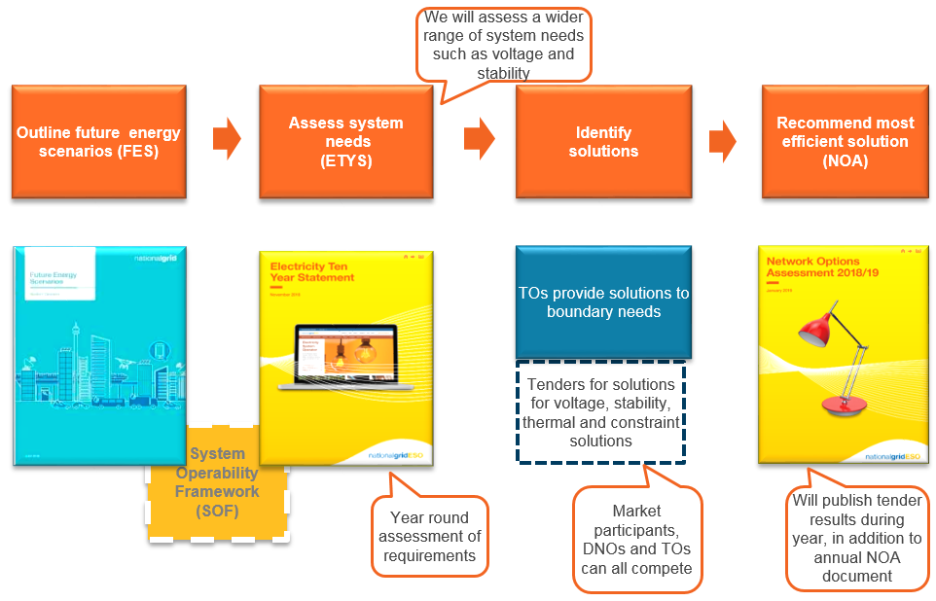
Network Development Roadmap - Pathfinders
Requirement
We are developing the NOA process to include the assessment of market solutions with network solutions
Proposed update
Procurement Guidelines – Update commercial ancillary services section to include pathfinder approach

Slide 16
GB Interconnectors
Susan Mwape
https://nationalgrid.onbrandcloud.com/login/

Slide 17
GB Interconnector capacity restrictions and payments
Overview:
CACM requires the development of regional Capacity Calculation Methodologies (CCM) which allows System Operators to reduce interconnector (IC) capacities.
The Day Ahead (DA) and Intraday (ID) methodologies were approved by Regulators in 2018 while the Long Term (LT) methodology is yet to be approved.
Due to the delay in the central CGM platform, implementation of the methodologies is delayed to at least Q4 2021.
Rationale:
The CCM does not include payment details.
The EU codes Capacity Allocation and Congestion Management (CACM) and the Forward Capacity Allocation (FCA) describes principles.
Discussions with interconnectors have been guided by the following principles:
Polluter pays
Single non-discriminatory GB payment
Revenue neutral
Maintains economic investment signals
GB Solution:
Under current GB mechanism, NGESO uses system trades and Intraday Transfer Limits to manage IC flows.
Initial view is that NTC restrictions should be treated as a Balancing service on the basis that BSUoS would be the correct mechanism to recover costs.
If treated as a balancing service, changes to BSUoS methodology may be needed hence NGESO is requesting industry participation through C16 consultation.

Slide 18
How to get involved
Consultation will be published here on the 4th November: https://www.nationalgrideso.com/codes/european-network-codes?meeting-docs
Industry workshops will be running in November & December, please contact box.europeancodes.electricity@nationalgrideso.com to register your interest

Slide 19
Next Steps
https://nationalgrid.onbrandcloud.com/login/

Slide 20
Next Steps
Early Consultation
The early consultation will be live Tuesday 12th Nov – Friday 13th Dec.
Consultation responses will be reviewed by NGESO Friday 13th Dec – Monday 13th Jan.
Consultation
The consultation will be live 13th Jan – 10th Feb.
Report to Authority
NGESO will produce the report to authority 10th Feb – 17th Feb.
Report will be submitted to Ofgem 17th Feb.
Ofgem review 17th Feb – 23rd March.
Statements published and go-live
Upon approval from Ofgem, statements will be published and go-live 1st April

Slide 21
nationalgrideso.com
Faraday House, Warwick Technology Park, Gallows Hill, Warwick, CV346DA

