Slide 1

Fast Reserve Post Assessment WebEx
July-19
https://nationalgrid.onbrandcloud.com/login/

Slide 2
Introduction
This WebEx:
    Relates to the results of the July FR tender round that were published on the website on the 17th July 2019
    Provides you with some more detailed feedback to ensure all suppliers are getting the same level of information.
During this webinar we will use WebEx to collect feedback about this session and other information we have provided. We would like to make you aware of the following:
    Any feedback that we collect will be anonymised.
    You can use an anonymous name and email address to login if you have any concerns.
    This information will only be used to improve the information we provide to you regarding the ancillary services.

Slide 3
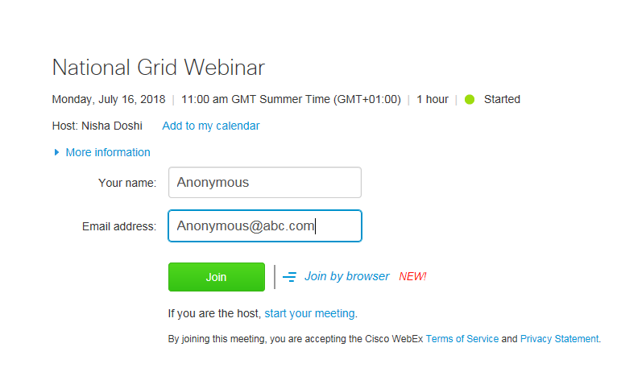
Anonymous login example

Slide 4

If you would like to logout and login anonymously please do so now.
Thank you
https://nationalgrid.onbrandcloud.com/login/

Slide 5
Representatives
 | Responsibility | Contact
Ralph Marlow | Constraint Analyst/ Ancillary Services Analyst | .box.AncillaryAssessment@nationalgrid.com
Kathryn Sorrell | Senior Constraint Analyst/ Ancillary Services Analyst | .box.AncillaryAssessment@nationalgrid.com
Steve Miller | Fast Reserve Service Lead/Account Manager | steve.k.miller@nationalgrideso.com

Slide 6
Contents
1 | Fast Reserve Assessment | [7]
2 | Fast Reserve Requirement | [8 & 9]
3 | Overview of Tenders | [10 - 13]
4 | Results | [14 & 15]
5 | Rejection Reason Codes | [16 - 19]
6 | Next Tender Round | [20]
7 | Feedback | [21]
8 | Questions | [22]

Slide 7
1. Fast Reserve Assessment
Step 1
    The forecasted cost of a tender are evaluated against the cost of obtaining an equivalent service in other markets. This includes:
        The cost of creating the equivalent reserve
        The alternative utilisation cost
        The cost of positioning units to offer fast acting reserve
    We account for the type of service delivered, duration of tender and availability window
        Utilisation restrictions such as periods of unavailability and MNZT are factored into the forecasted contract cost.
        Maximum utilisation volumes are accounted for in the forecasted utilisation volume
        Windows with durations beyond the requirement are valued based on forecasts of potential utilisation volumes
Step 2
    Tenders are stacked in terms of benefit delivered against any outstanding requirement.
Step 3
    Where applicable, any possible over holding is also accounted for in the assessment.

Slide 8
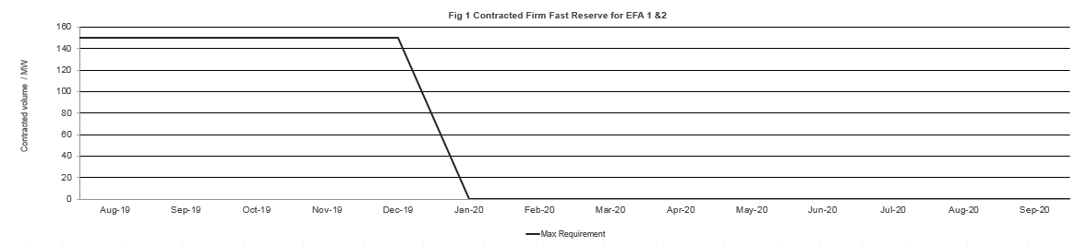
2. Fast Reserve Requirement
The primary focus was to procure volume as per the published tender calendar to be delivered in:
    August 2019 for EFA blocks 1 & 2.

Slide 9
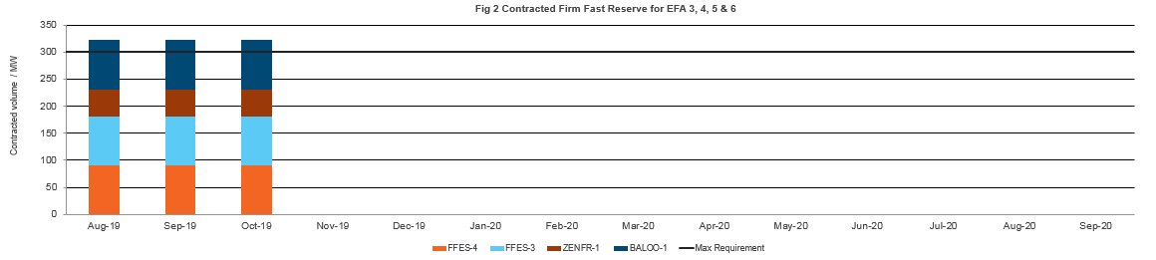
2. Fast Reserve Requirement
We also considered procuring volume as per the published tender calendar to be delivered in:
    November 2019 to December 2019 for EFA blocks 3, 4, 5 & 6.
    November 2019 to March 2020 for EFA blocks 3, 4, 5 & 6.
    April 2020 to September 2020 for EFA blocks 3, 4, 5 & 6.

Slide 10
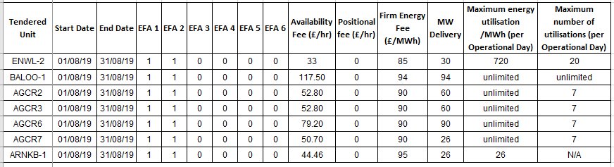
3. Overview of tenders

Slide 11
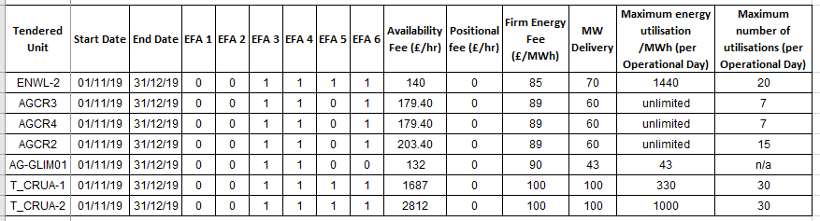
3. Overview of tenders

Slide 12
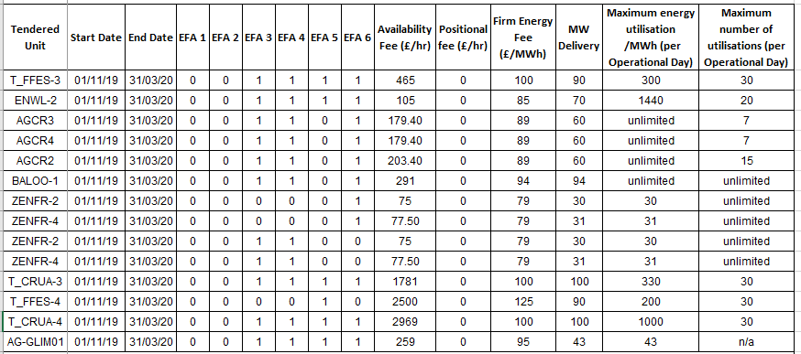
3. Overview of tenders

Slide 13
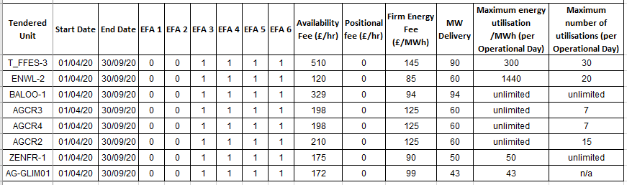
3. Overview of tenders

Slide 14
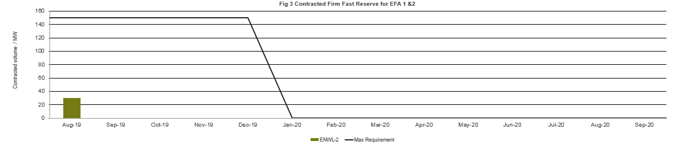
4. Results
    30MW was procured from ENWL-2 for delivery in August 2019 for EFA 1 & 2

Slide 15
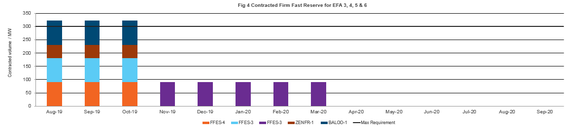
4. Results
    90MW was procured from FFES-3 for delivery from November 2019 to March 2020 for EFA 3, 4, 5 & 6

Slide 16
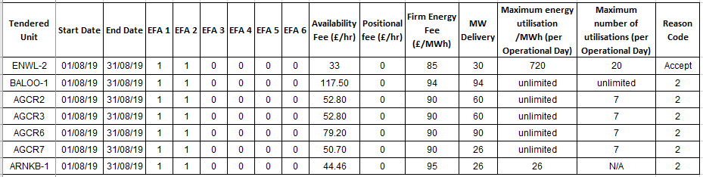
5. Rejection reason codes

Slide 17
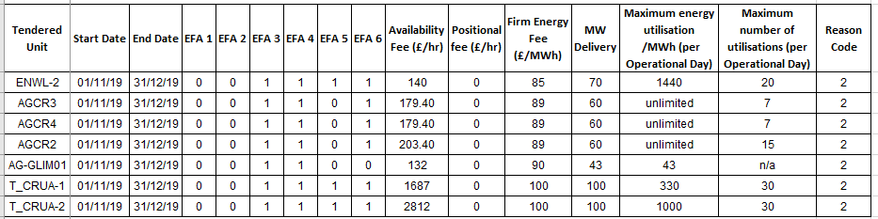
5. Rejection reason codes

Slide 18
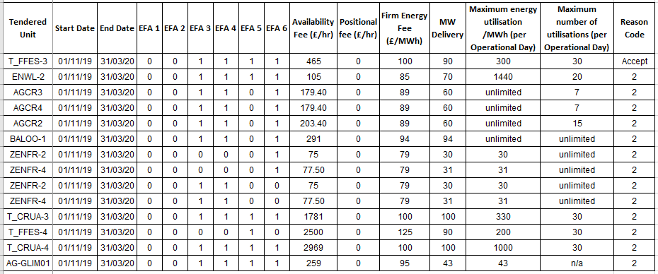
5. Rejection reason codes

Slide 19
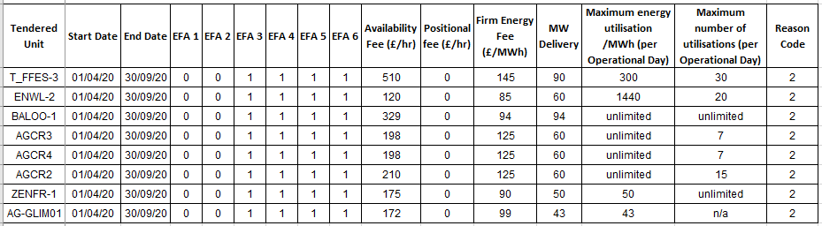
5. Rejection reason codes

Slide 20
6. Next Tender Round
Market Information Report will be published later today 23rd July
Tender submission deadline will be 5pm on 1st August
Notification of outcome of the tender assessment by 16th August
Results published online by 16th August
In line with the tender calendar, in the August tender we will only be procuring for EFA blocks 1 & 2 for September 2019.
As part of the implementation of the OCP we are reviewing our requirements and procurement strategy. Any additional volume that may be procured will be communicated through the Market information report.

Slide 21

7. Feedback
Before we move onto the questions section, we ask you to leave your feedback using Webex live poll that will shortly be appearing on your screen shortly
https://nationalgrid.onbrandcloud.com/login/

Slide 22
8. Questions
Please ask your questions via the WebEx chat function
If we are unable to offer an answer to a question on the call, we will take it away and provide an answer back in writing to all those on the call.
NGESO reserve the right to refuse to answer any questions deemed inappropriate.
https://nationalgrid.onbrandcloud.com/login/

Slide 23
nationalgrideso.com
  National Grid ESO, Faraday House, Warwick Technology Park,
  Gallows Hill, Warwick, CV346DA

