Slide 1

Fast Reserve Post Assessment WebEx
June-19
https://nationalgrid.onbrandcloud.com/login/

Slide 2
Introduction
This WebEx:
    Relates to the results of the June FR tender round that were published on the website on the 18th June 2019
    Provides you with some more detailed feedback to ensure all suppliers are getting the same level of information.
During this webinar we will use WebEx to collect feedback about this session and other information we have provided. We would like to make you aware of the following:
    Any feedback that we collect will be anonymised.
    You can use an anonymous name and email address to login if you have any concerns.
    This information will only be used to improve the information we provide to you regarding the ancillary services.

Slide 3
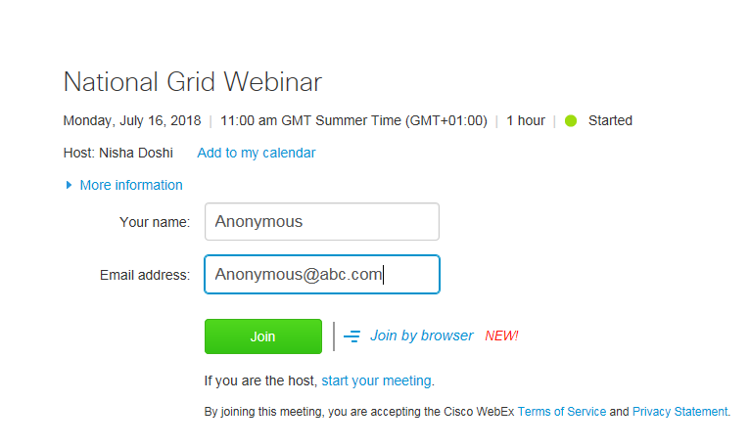
Anonymous login example

Slide 4

If you would like to logout and login anonymously please do so now.
Thank you
https://nationalgrid.onbrandcloud.com/login/

Slide 5
Representatives
 | Responsibility | Contact
Ralph Marlow | Constraint Analyst/ Ancillary Services Analyst | .box.AncillaryAssessment@nationalgrid.com
Kathryn Sorrell | Senior Constraint Analyst/ Ancillary Services Analyst | .box.AncillaryAssessment@nationalgrid.com
Steve Miller | Fast Reserve Service Lead/Account Manager | steve.k.miller@nationalgrideso.com

Slide 6
Contents
1 | Fast Reserve Assessment | [7]
2 | Fast Reserve Requirement | [8]
3 | Overview of Tenders | [9]
4 | Results | [10]
5 | Graph of Tenders | [11]
6 | Rejection Reason Codes | [12]
7 | Next Tender Round | [13]
8 | Coupa Web Platform | [14]
9 | Feedback | [15]
10 | Questions | [16]

Slide 7
1. Fast Reserve Assessment
Step 1
    The forecasted cost of a tender are evaluated against the cost of obtaining an equivalent service in the optional market. This includes:
        The cost of creating the equivalent reserve
        The alternative utilisation cost
        The cost of positioning units to offer fast acting reserve
    We account for the type of service delivered, duration of tender and availability window
        Utilisation restrictions such as periods of unavailability and MNZT are factored into the forecasted contract cost.
        Maximum utilisation volumes are accounted for in the forecasted utilisation volume
        Windows with durations beyond the requirement are valued based on forecasts of potential utilisation volumes
Step 2
    Tenders are stacked in terms of benefit delivered against any outstanding requirement.
Step 3
    Where applicable, any possible over holding is also accounted for in the assessment.

Slide 8
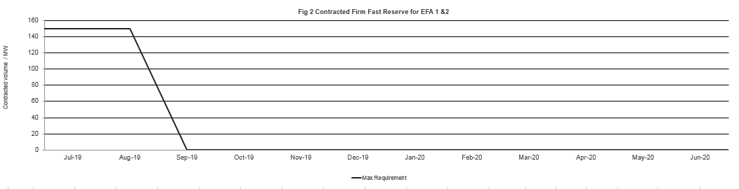
2.Fast Reserve Requirement
It was the intention to consider procuring volume to be delivered in:
    July 2019 for EFA block 1 & 2, as per the published tender calendar

Slide 9
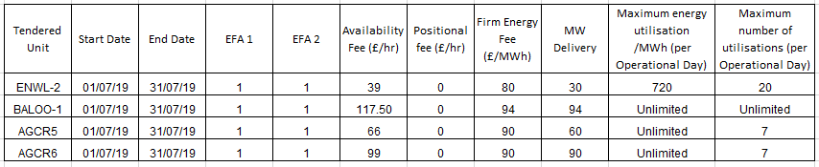
3. Overview of tenders

Slide 10
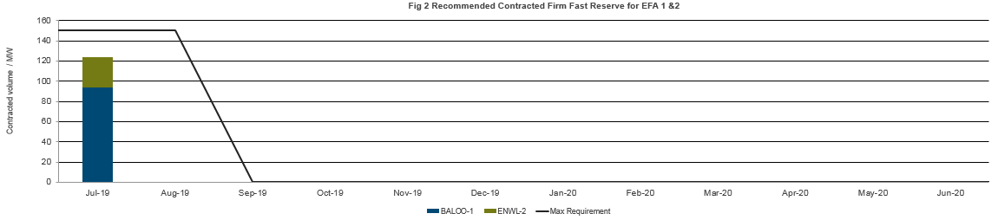
4. Results
    124MW was procured for delivery in July 2019 for EFA 1 & 2
    94MW from BALOO-1 and 30MW from ENWL-2

Slide 11
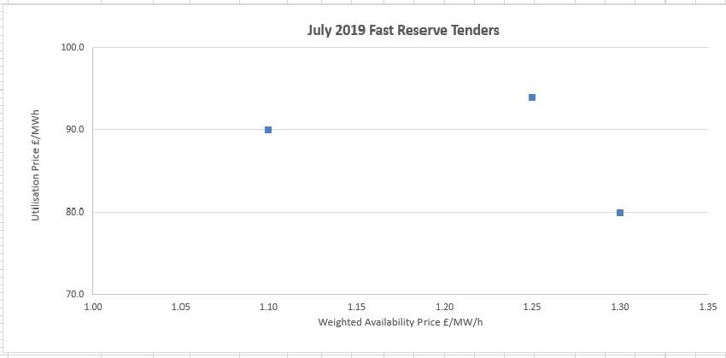
5. Overview of tenders
Accepted Tender
Accepted Tender

Slide 12
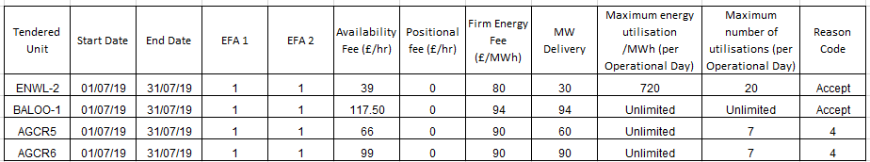
6. Rejection reason codes

Slide 13
7. Next Tender round
Market Information Report will be published later today 26th June
Tender submission deadline will be 5pm on 1st July
Notification of outcome of the tender assessment by 16th July
Results published online by 18th July
In line with the tender calendar, in the July tender we will be procuring for EFA blocks 1 & 2 for August 2019 and for EFA blocks 3, 4, 5 & 6 for November 2019 to September 2020
As part of the implementation of the OCP we are reviewing our requirements and procurement strategy. Any additional volume that may be procured will be communicated through the Market information report.

Slide 14
Coupa Web Platform
From July 2019 we are using a tendering platform called Coupa.
All providers who were registered for FR tender events on Ariba will have received an email to sign into the new system.
Upload your tender proforma (the same as you did in Ariba), there is no need to complete any of the fields.
One of the restrictions with Coupa is that an email can only be used once per tendered service
For multiple tender submissions please either use one tender proforma with all the tenders entered or upload a zip file containing multiple tender proformas.
As this is the 1st time using Coupa, we request that you also send a copy of you tender to the commercial .box Commercial.Operation@nationalgrideso.com

Slide 15

8. Feedback
Before we move onto the questions section, we ask you to leave your feedback using Webex live poll that will shortly be appearing on your screen shortly
https://nationalgrid.onbrandcloud.com/login/

Slide 16
9. Questions
Please ask your questions via the WebEx chat function
If we are unable to offer an answer to a question on the call, we will take it away and provide an answer back in writing to all those on the call.
NGESO reserve the right to refuse to answer any questions deemed inappropriate.
https://nationalgrid.onbrandcloud.com/login/

Slide 17
nationalgrideso.com
  National Grid ESO, Faraday House, Warwick Technology Park,
  Gallows Hill, Warwick, CV346DA

