Slide 1

Fast Reserve Post Assessment WebEx
April-19
https://nationalgrid.onbrandcloud.com/login/

Slide 2
Introduction
This WebEx:
    Relates to the results of the April FR tender round that were published on the website on the 18th April 2019
    Provides you with some more detailed feedback to ensure all suppliers are getting the same level of information.
During this webinar we will use WebEx to collect feedback about this session and other information we have provided. We would like to make you aware of the following:
    Any feedback that we collect will be anonymised.
    You can use an anonymous name and email address to login if you have any concerns.
    This information will only be used to improve the information we provide to you regarding the ancillary services.

Slide 3
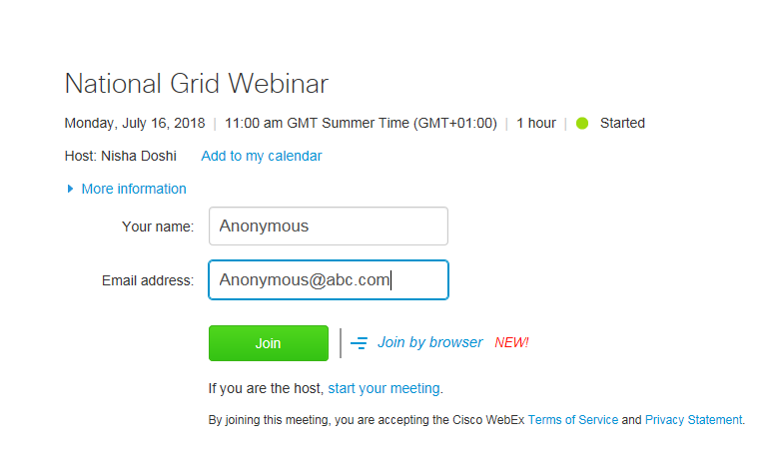
Anonymous login example

Slide 4

If you would like to logout and login anonymously please do so now.
Thank you
https://nationalgrid.onbrandcloud.com/login/

Slide 5
Representatives
 | Responsibility | Contact
Kathryn Sorrell | Senior Constraint Analyst/ Ancillary Services Analyst | .box.AncillaryAssessment@nationalgrid.com
Steve Miller | Fast Reserve Service Lead/Account Manager | Steve.k.miller@nationalgrideso.com

Slide 6
Contents
1 | Fast Reserve Assessment | [7]
2 | Fast Reserve Requirement | [8]
3 | Overview of Tenders | [9]
4 | Results | [10]
5 | Graph of Tenders for EFA 1 & 2 | [11]
6 | Rejection Reason Codes | [12]
7 | Next Tender Round | [13]
8 | Feedback | [14]
9 | Questions | [15]

Slide 7
1. Fast Reserve Assessment
Step 1
    The forecasted cost of a tender are evaluated against the cost of obtaining an equivalent service in the optional market. This includes:
        The cost of creating the equivalent reserve
        The alternative utilisation cost
        The cost of positioning units to offer fast acting reserve
    We account for the type of service delivered, duration of tender and availability window
        Utilisation restrictions such as periods of unavailability and MNZT are factored into the forecasted contract cost.
        Maximum utilisation volumes are accounted for in the forecasted utilisation volume
        Windows with durations beyond the requirement are valued based on forecasts of potential utilisation volumes
Step 2
    Tenders are stacked in terms of benefit delivered against any outstanding requirement.
Step 3
    Where applicable, any possible over holding is also accounted for in the assessment.

Slide 8
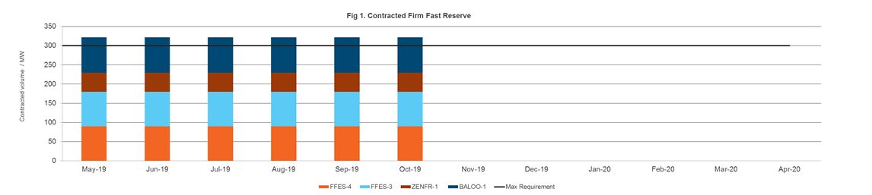
2.Fast Reserve Requirement
It was the intension to consider procuring volume to be delivered in:
    May 2019 for EFA block 1 & 2
    Nov 2019 to March 2020 for EFA block 3,4,5 & 6

Slide 9
3. Overview of tenders

Slide 10
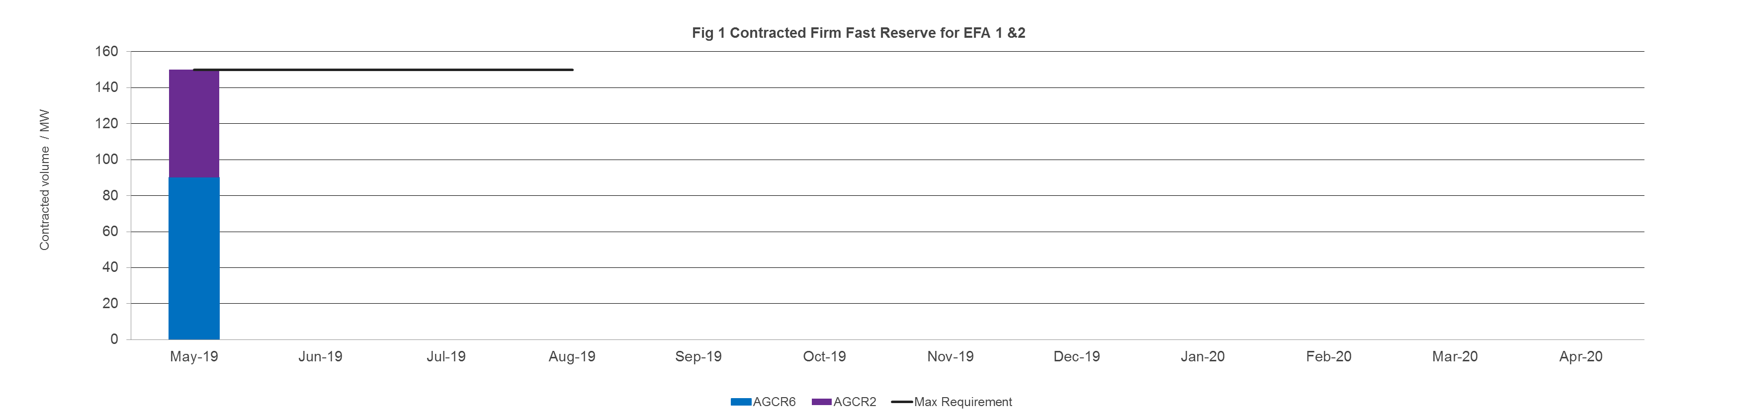
4. Results
    0MW were procured for delivery from Nov 2019 to March 2020 for EFA 3, 4, 5 & 6. The next opportunity to tender for this season will be in July 2019.
    150MW was procured for delivery in May 2019 for EFA 1 & 2

Slide 11
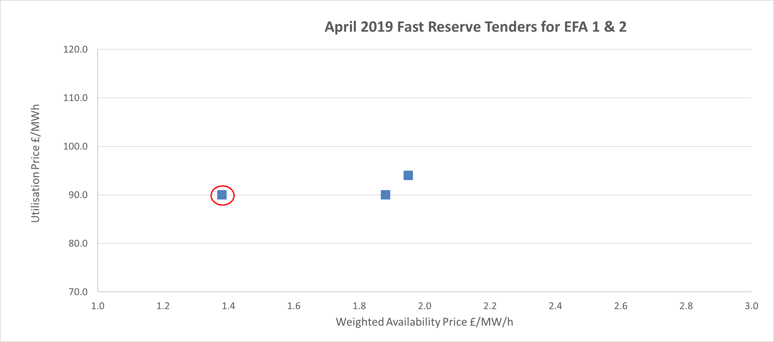
8. Overview of tenders
Accepted
Tenders

Slide 12
5. Rejection reason codes

Slide 13
6. Next Tender round
Market Information Report will be published by 25th April
Tender submission deadline will be 5pm on 1st May
Notification of outcome of the tender assessment by 17th May
Results published online by 20th May
In line with the tender calendar, in the May tender we will only be procuring for EFA block 1 & 2 for June 2019
As part of the implementation of the OCP we are reviewing our requirements and procurement strategy. Any additional volume that may be procured will be communicated through the Market information report.

Slide 14

8. Feedback
Before we move onto the questions section, we ask you to leave your feedback using Webex live poll that will shortly be appearing on your screen shortly
https://nationalgrid.onbrandcloud.com/login/

Slide 15
9. Questions
Please ask your questions via the WebEx chat function
If we are unable to offer an answer to a question on the call, we will take it away and provide an answer back in writing to all those on the call.
NGESO reserve the right to refuse to answer any questions deemed inappropriate.
https://nationalgrid.onbrandcloud.com/login/

Slide 16
nationalgrideso.com
  National Grid ESO, Faraday House, Warwick Technology Park,
  Gallows Hill, Warwick, CV346DA

