Slide 1

GC0087 Frequency Response Provisions
Fiona Williams
National Grid – Technical Policy
18 October 2016

Slide 2
GC0087 – where we are now
All parameters agreed except RoCoF withstand capability
Workgroup report and code drafting currently underway
RoCoF withstand being studied using current SOF data
Proposals for parameter setting below

Slide 3
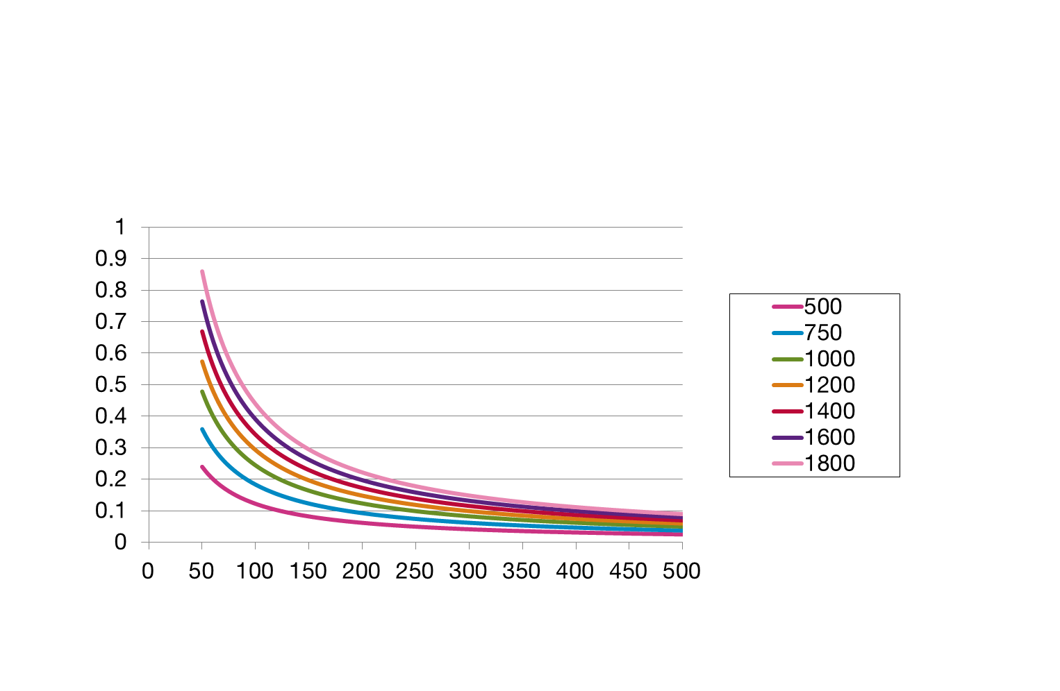
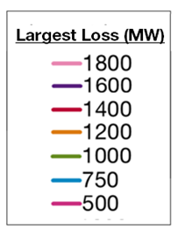
RoCoF and Inertia Relationship (SOF 2016 data)
Minimum seen in 2016
This plot shows the relationship between system inertia, RoCoF and the largest loss risk on the system
As system inertia decreases and the largest loss increases, the RoCoF risk increases
The minimum inertia witnessed so far in 2016 was about 135GVA.s, limiting the largest loss to 680MW
RoCoF (Hz/s)
0.125Hz/s
System Inertia (GVA.s)

Slide 4
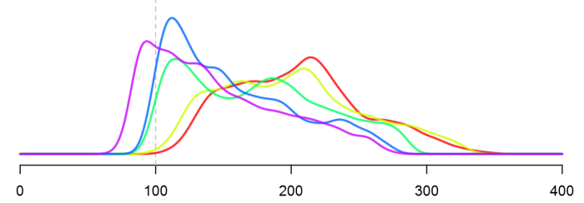
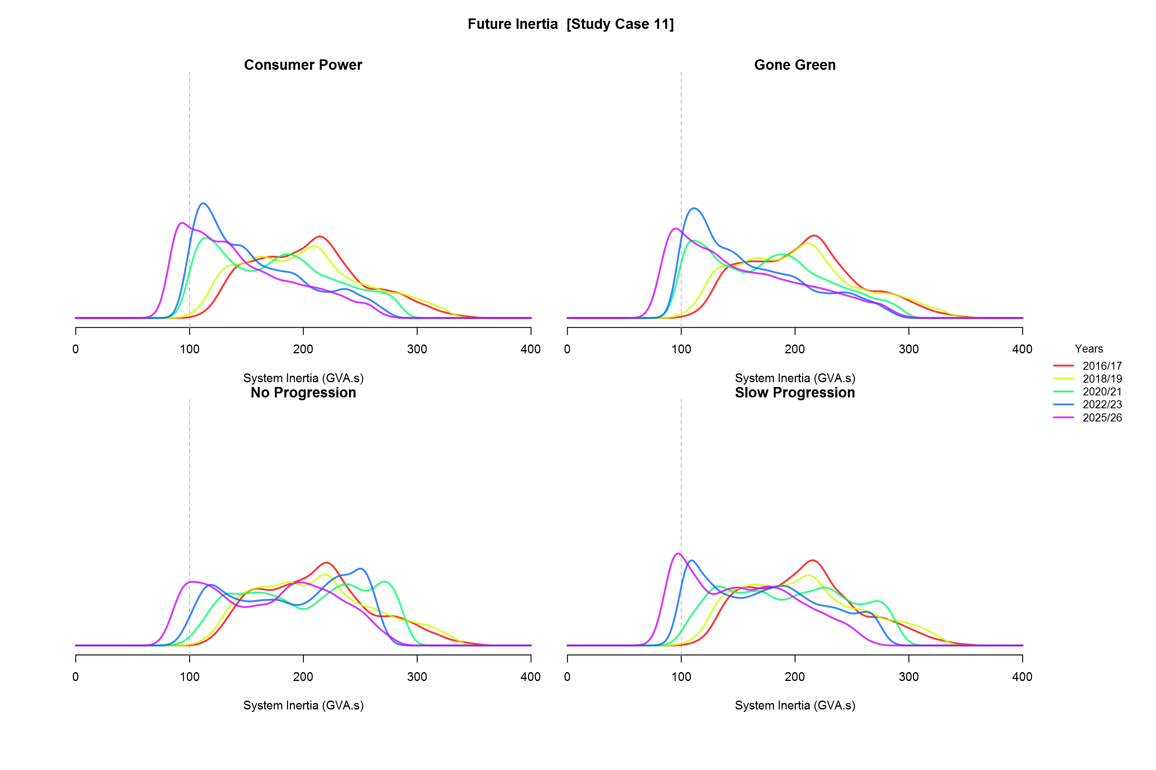
System Inertia – Consumer Power
Annual Distribution of System Inertia
System Inertia (GVA.s)

Slide 5
SOF data
Robust data
Combination of actual and FES
Reference days chosen in 2 week date window with similar weather (wind and solar) conditions
Historic transmission demand stripped of embedded to provide real demand data and then predicted embedded values added to produce future demand figures
FES merit order used
http://www2.nationalgrid.com/UK/Industry-information/Future-of-Energy/System-Operability-Framework/ - more detail on data in the webinars

Slide 6
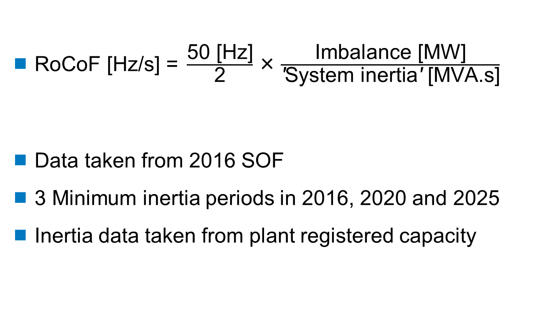
Theory behind the data
$\text{RoCoF}\text{ [}\text{Hz}\text{/}\text{s}\text{] = }\frac{\text{50 [}\text{Hz}\text{]}}{\text{2}}\text{×}\frac{\text{Imbalance}\text{ [}\text{MW}\text{]}}{\text{′}\text{System} \text{inertia}\text{′}\text{ [}\text{MVA}\text{.}\text{s}\text{]}}$
Data taken from 2016 SOF
3 Minimum inertia periods in 2016, 2020 and 2025
Inertia data taken from plant registered capacity

Slide 7
RfG Definition of RoCoF Withstand Capability
  With regard to the rate of change of frequency withstand capability, a power generating module shall be capable of staying connected to the network and operate at rates of change of frequency up to a value specified by the relevant TSO, unless disconnection was triggered by rate-of-change-of-frequency-type loss of mains protection. The relevant system operator, in coordination with the relevant TSO, shall specify this rate-of-change-of-frequency-type loss of mains protection.

Slide 8
Study data
Year | Min MVA.s | 1260 | 1500 | 1800
2016 | 103777 | -0.30 | -0.36 | -0.43
2020 | 86678 | -0.36 | -0.43 | -0.52
2025 | 69772 | -0.45 | -0.54 | -0.64

Slide 9
Breakdown of the Minimums
Year | % of plant with inertia | % of plant without inertia | Demand (MW)
2016 | 77 | 23 | 16,866
2020 | 65 | 35 | 16,821
2025 | 51 | 49 | 13,672

Slide 10
Work in GC0035 – conclusions for LOM protection settings (>5MW)
http://www2.nationalgrid.com/UK/Industry-information/Electricity-codes/Grid-code/Modifications/GC0035-GC0079/ - authority decision tab
Authority decision for a RoCoF protection setting of 1Hz/s for all new and existing non-synchronous generators
And, 0.5Hz/s for all existing synchronous generators
All new synchronous generators 1Hz/s for commissioning on or after 1 July 2016
All to be measured continuously for 500ms

Slide 11
Proposed Withstand Limits
Data clearly showing > 0.5 Hz/s requirement by 2025
1Hz/s required to cover islanding risk
Whole system affected by frequency event therefore previously agreed distribution limits should not apply only to embedded generation
Specifying a minimum for plant to connect in next 5 years and operate for next 20-40 years and therefore generate well beyond 2025
Need to ensure all new plant is fit for changing energy landscape…………….

