Slide 1
Wind Market Data
8th October 2014

Slide 2
Power Available visibility to the market
If Power Available via Option 3 were introduced, concern expressed over data that may be available to the System Operator that would not be available to the market.
What value would a Power Available signal provide to the market?
To aid this consideration, we set out the data elements that are currently available:
Market players subscribe to high grade BMRS service providing forecast and actual data for their trading systems.
Perception that market able to calculate aggregate wind position based on metered output with existing data (including their own data).

Slide 3
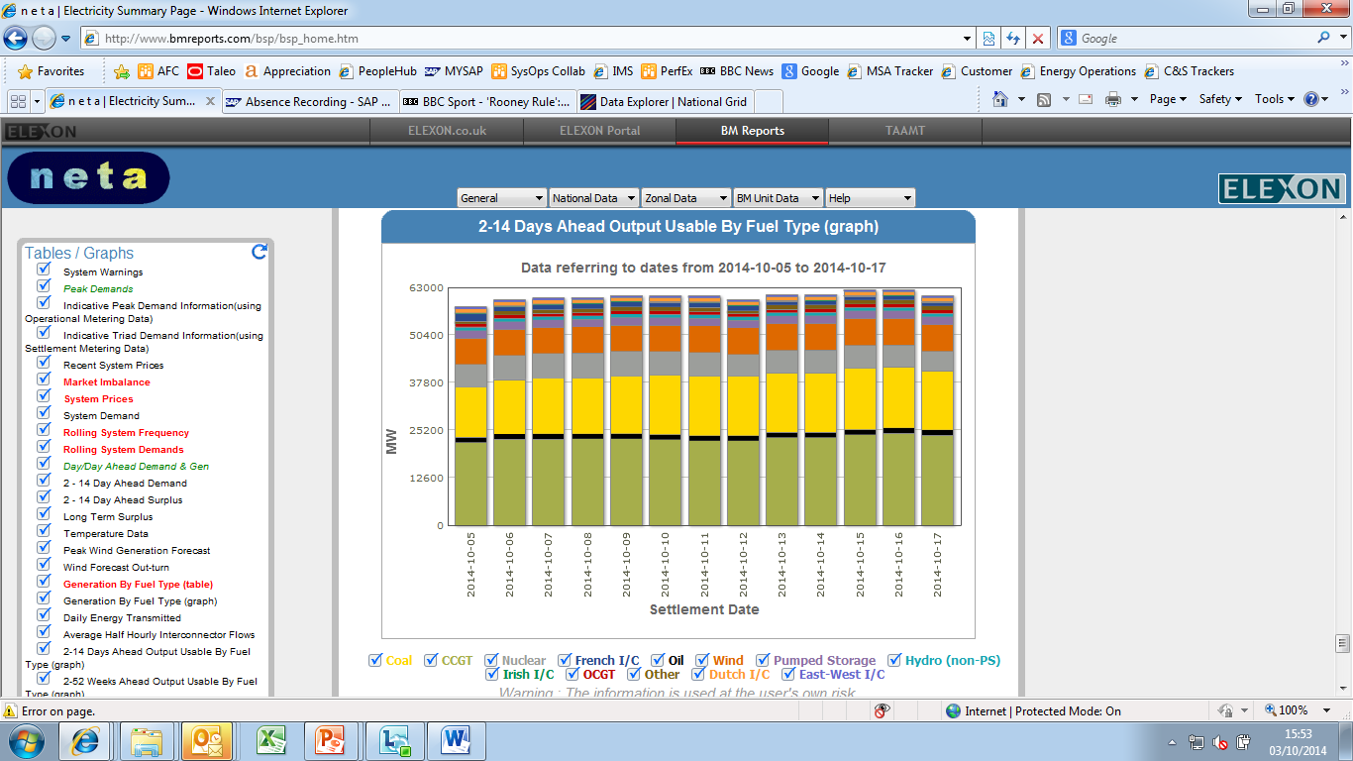
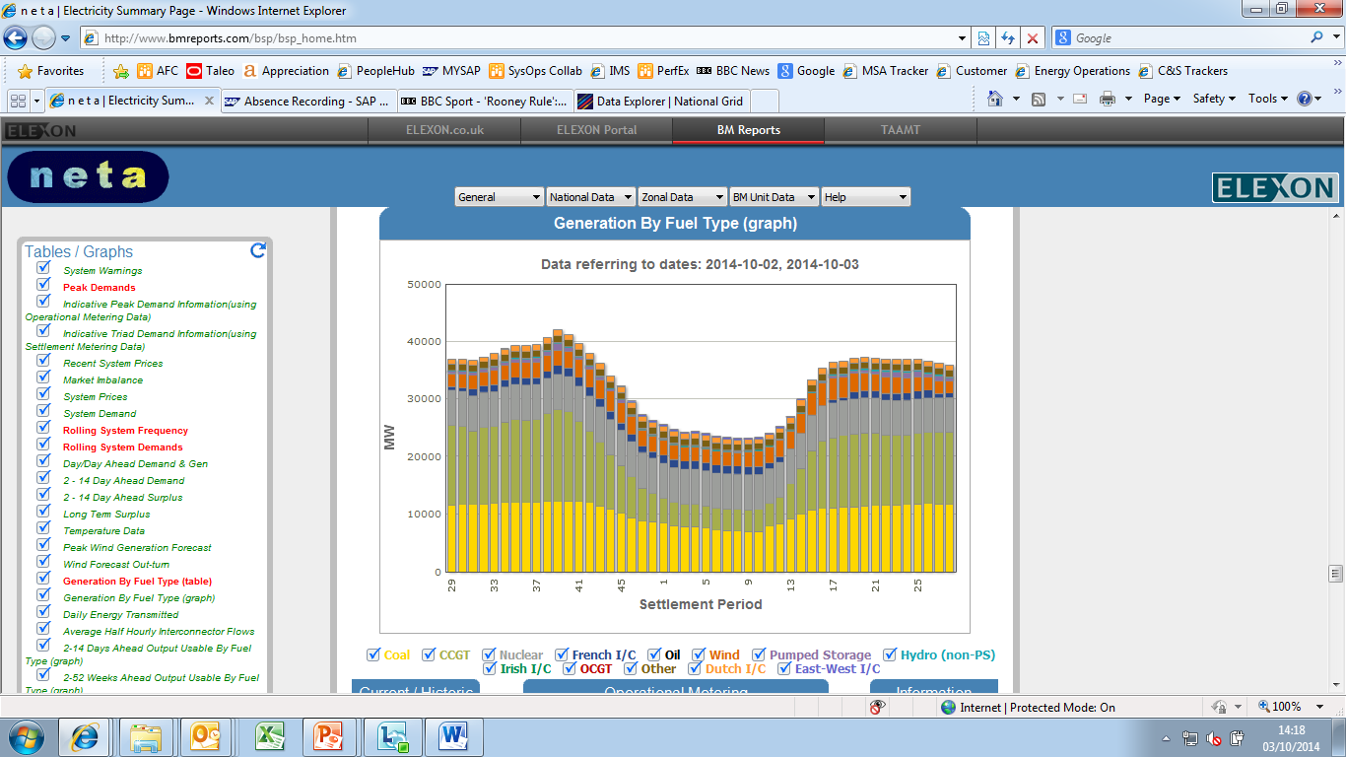
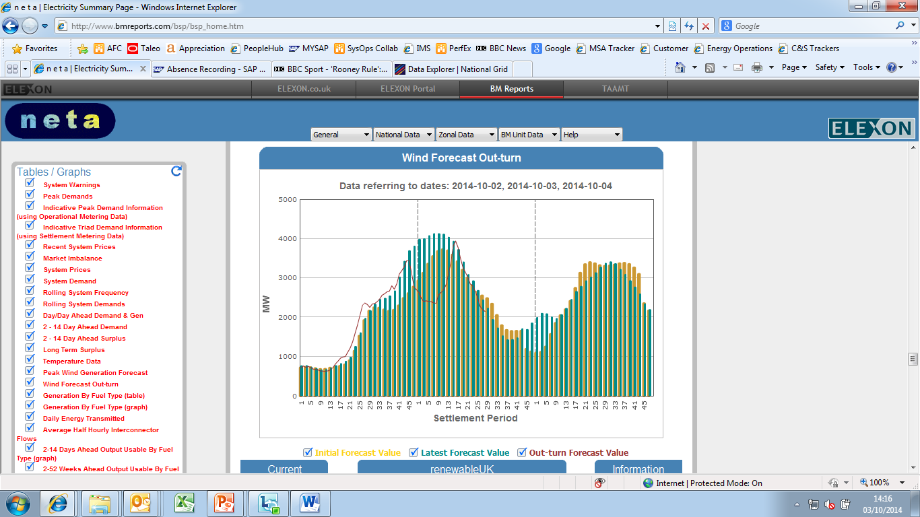
Wind Data available to the market
Output useable (Derived from MEL)
BM Unit BOA volumes published
Metered output by fuel type / SP)
NG Trans. wind forecast
National Grid Embedded forecast
+
Forwards Market
Balancing Mechanism
Gate Closure (1hr)

Slide 4
Wind data components
Forecast data
Transmission connected wind forecast run every 6 hrs for next 1 hr to 10 days: published via BMRS (high and low grade service) http://www.bmreports.com/bsp/bsp_home.htm
Distribution connected renewable generation forecast every dayhttp://www2.nationalgrid.com/UK/Industry-information/Electricity-transmission-operational-data/Data-Explorer/
Metered output
Aggregated total output by fuel type and PNs for BMU by settlement period every half hour; published via BMRS
Capability
MEL available updates every half hour – we assume market players discard current Wind MEL data.

